Slide 1


LEGISLATIVE EXECUTIVE JUDICIAL
3 Levels of Government
Directions: On your own paper, draw the following chart. In each box include (1) who makes up each branch and (2)their main job
National: |  |  | -U.S. Supreme Court -Interpret U.S. laws
State: | -General Assembly (House & Senate) -Make state laws
Local:

Slide 2

The 3 Branches of the National Government

Slide 3
Separation of Powers
The system in which each branch of government has its own powers.
Legislative
Executive
Judicial
Makes Laws
Interprets Laws
Executes Laws

Slide 4

National Government
The Legislative Branch
Legislative Branch: Article I
Congress
Responsibility: Make Laws
Congress: Consists of 2 Houses (bicameral)
1. Senate: Equal Representation
100 Total Members (2 from each State) Senators Serve a 6 year term
2. House of Representatives:
Members are based on population
435 Total members today
House Members Serve a 2 year term

Slide 5
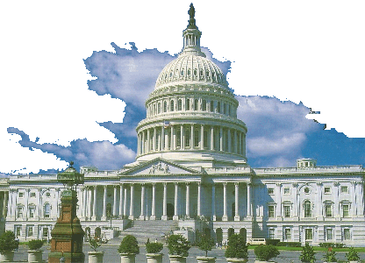
Legislative Branch
That means
2 from EVERY state!
The House of Representatives are based on a state’s POPULATION
And the Senate has
EQUAL REPRESENTATION
Notes:
5

Slide 6


Executive
The Executive Branch is made up of The President, Vice President and his Cabinet (or Administrative Departments)
Their job is to Enforce (execute) Laws!
Notes:
6

Slide 7

The Executive Branch
Executive Branch: Article II
President / Vice Pres./ Cabinet
Responsibility: Enforce Laws
President’s Term: 4 years
The Executive Branch makes sure people follow the laws that the Legislative Branch makes.
When making important decisions, the President often asks for advice from the Cabinet (President’s advisors)

Slide 8
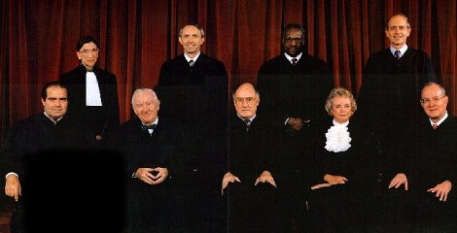
THE JUDICIAL BRANCH
The Supreme Court
decides if a law
is constitutional or not
Judicial Review
Judges interpret the law

Slide 9
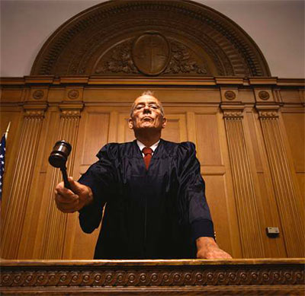
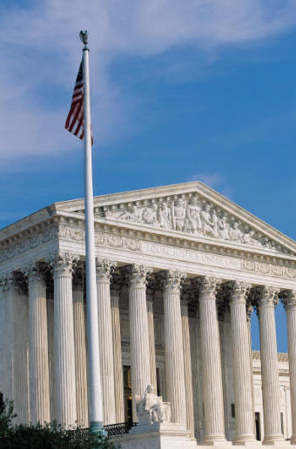
National Government:
The Judicial Branch
Judicial Branch: Article III
U.S. Supreme Court (9 justices)
Primary Responsibility: Interpret Laws
Judicial Review: When people are unsure about the meaning of a law, the Judicial Branch listens to many opinions and makes a decision on whether the law is constitutional or not.

Slide 10

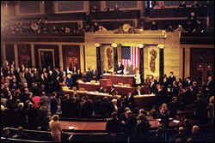
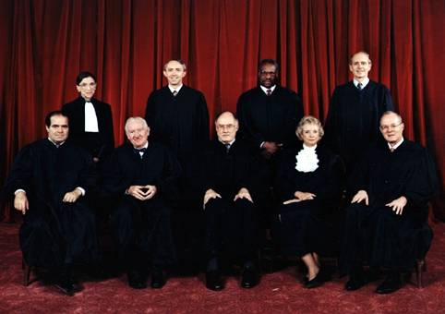
Congress can impeach the
President .
Checks and Balances
President can veto (reject) laws
The Supreme Court decides if laws Congress makes are unconstitutional.
.
Each branch
checks the others
so that no one is
too powerful

Slide 11

Each state has its own constitution based on its unique history, needs, philosophy, and geography.
Just like our national government, each state's constitution separates power between three branches…
Legislative, Executive, and Judicial

Slide 12


North Carolina Government
The Legislative Branch
NC Legislative Branch: General Assembly
Responsibility: Makes state laws
Currently, 120 State Representatives
The General Assembly is made up of two parts (bicameral).
Currently, 50 State Senators

Slide 13

North Carolina Government:
The Executive Branch
Executive Branch: NC Governor
NC Lt. Governor
Responsibility: Enforce state laws
Current NC Governor: Pat McCrory

Slide 14


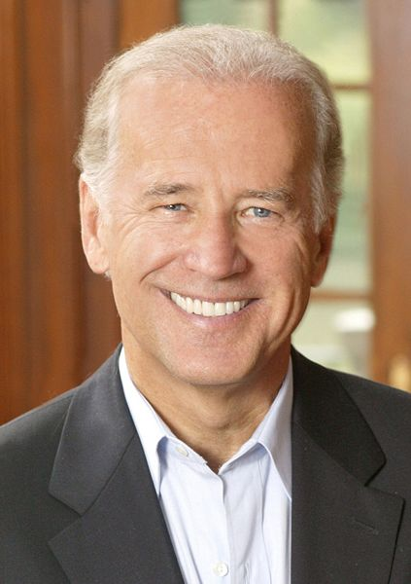

National vs. NC Government:
President Barack Obama
Governor:
Pat McCrory
NC’s Executive Branch is headed by the Governor, who carries out and enforces laws made by the General Assembly (NC’s Legislature or Congress)
Lt. Governor
Dan Forest
Vice President Joe Biden

Slide 15
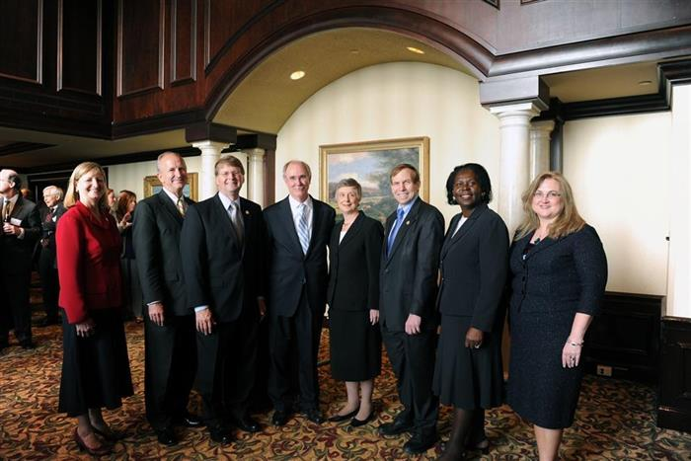
North Carolina Government:
The Judicial Branch
NC Judicial Branch: NC Supreme Court (7 justices)
Main responsibility: Interpret state laws

Slide 16

NC Local Government (Charlotte)
Legislative Branch: City Council
  Responsibility: Make city laws
Executive Branch: Mayor
  Responsibility: Enforce city laws
Judicial Branch: District Court
  Responsibility: Interpret city laws

