Slide 1
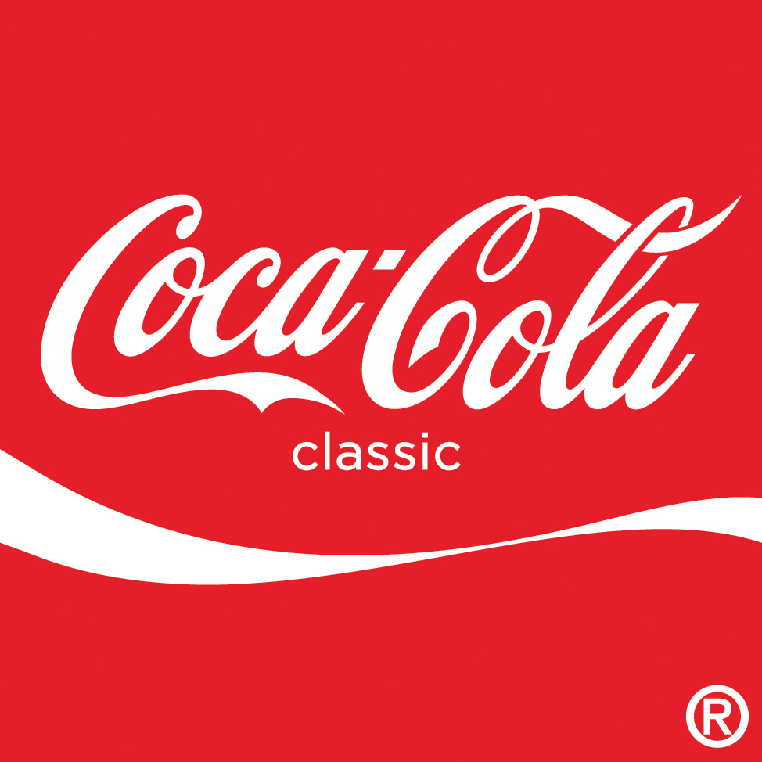
Warm Up
If you could start a business would you work on your own or with a partner? Why?

Slide 2
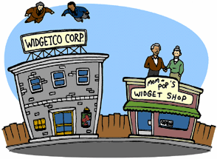
Sole Proprietorships
business owned and operated by ONE person. Most common.
PROS: make all the profits
CONS:
unlimited liability—responsible for all debts.
Must raise all start-up capital (human, physical and financial)

Slide 3
Partnerships
A partnership is a business owned by 2 or more people.
PROS:
Share the burden of debt and capital.
Raise $$ by adding partners
No corporate income tax
CONS:
each partner has unlimited liability

Slide 4
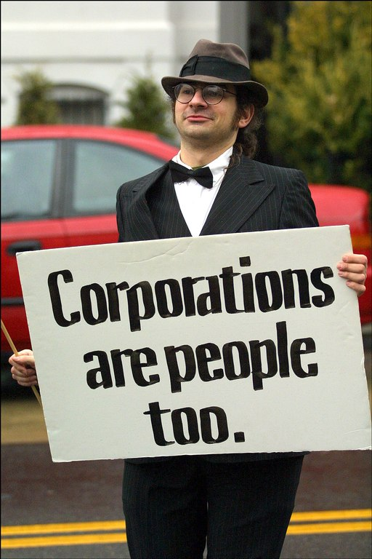
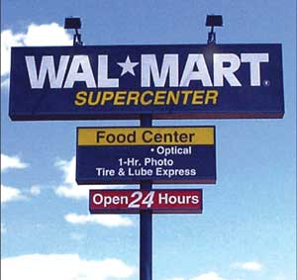
Corporations
A corporation is a business formed by filing a charter with the gov’t.
Stockholders who buy shares OWN the corporation.
Board of Directors is hired to run the business
PROS:
Raise money easily through selling stock
Limited liability (only liable for your investment)
CONS:
Gov’t regulation and corporate tax
Owners have little say in management of corporation

Slide 5
Nonprofit Organizations
“do good” organization, which operates in a businesslike way.

Slide 6
Investment-Spend $ to make $
What you can invest in and how you can invest your money
Human Capital
the people—through pay, benefits, education and training to increase productivity!
Physical Capital
Machinery, Technology, buildings, tools
Natural resources
Land (renewable & nonrenewable resources)
Financial Capital- MAKE MY $$$ GROW!!!
Stock
Certificate of Deposit (CD)-long term
Bond
Venture Capital
Investment in a NEW business

Slide 7
OVERALL
Investment seeks to increase productivity by increasing inputs.
EX: I invest in machinery (input) and I get more cars (output)

Slide 8
Create a Business!
Name Business
State the major good or service you will be producing.
State the TYPE of Business (corporation, sole proprietorship, partnership)?
Identify your fixed costs
What investments will you make to get started?
Human Capital (how many workers, what types of jobs, skilled or unskilled workers?)
Financial Capital
Physical Capital

