Slide 2
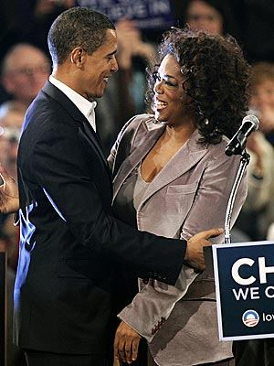
Testimonial
Testimonial: getting famous people to endorse your position

Slide 3
Glittering Generalities
Glittering Generalities: A message that is too general with no specific plan. Ex: “I will solve poverty in America because I believe in hope and possibility.”

Slide 4
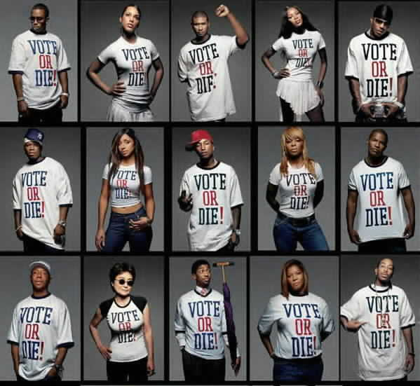
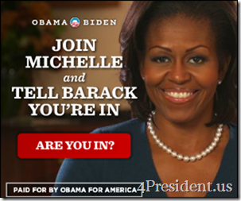
Bandwagon: appealing to people by telling them they should join your group. Everyone is doing it!

Slide 5
Card-Stacking:
Card-Stacking: Leaving out information or only presenting ONE side of issue

Slide 6
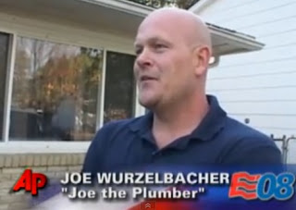
Plain Folks Appeal:
Plain Folks Appeal: Appealing to regular people's values. Showing people you’re just like them.

Slide 7
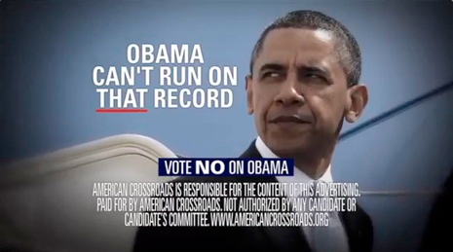
Negative Campaigning
Name-calling: trash talking about another candidate. Also known as “mudslinging.”
Presenting what negative things could happen if you do not vote for them

