Slide 1
CE-Notes 73-74

Slide 2
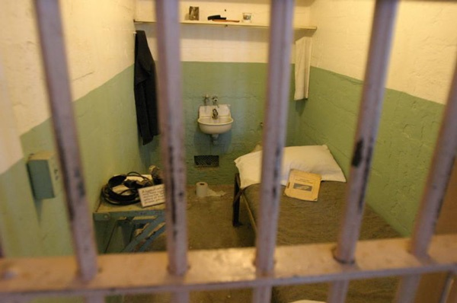
Objectives
SWBAT assess methods used by society to address criminal behaviors.

Slide 3
Discuss-
If you are unaware of a law and break it should you still be punished?

Slide 4
NOTES
Citizens must keep themselves informed of laws, BUT…
It is the responsibility of the government to provide the information.
Legislative branch must inform the public of new laws.
That is why legislators get to send mail for free, this is called the Franking Privilege.
Not knowing something was against the law is NOT an excuse or a defense.

Slide 5
Media
Newspapers, TV, and the Internet all let us know what is going on in Government.
________________ reaches the most people
________________ provide the deepest coverage of events.
The ________________ has the most up to date information.
The media also acts as a “watchdog” letting us know when our gov’t is corrupt.

Slide 6
Different reasons why we punish criminals:
Retribution: Criminals deserve punishment because of the harm they inflicted on society.
Similar to “an eye for an eye”
Deterrence: Punishments will make people less likely to commit crimes
Rehabilitation: the bodies of criminals should not be punished their minds need to be reeducated.

Slide 7
Types of Punishment-Convicted Felons
Prison terms of substantial length
Loss of Privileges such as professional licenses, public offices, or public employment, voting, driver’s license
Capital Punishment-death penalty
Restitution- pay money to the victim or the judicial system

Slide 8
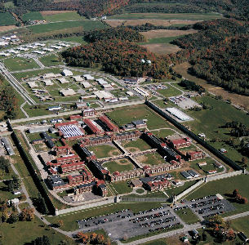
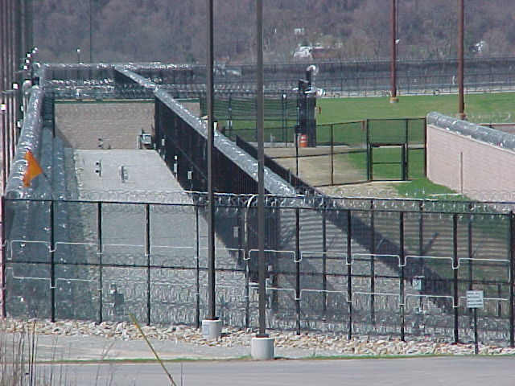
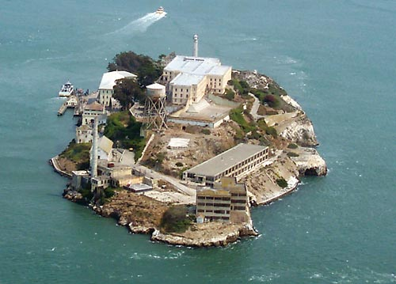
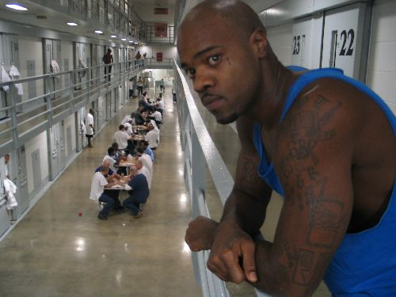

Slide 9
US Prison Statistics
70,000 inmates are released from prison each year. More than 2/3 (67%) of them end up back behind bars within 3 years.
Overcrowding in prisons→leads to the early release or “parole” of prisoners.
2,310,984 prisoners are held in federal or state prisons or in local jails
America's jails hold 1 in every 142 U.S. residents.
Males are incarcerated at the rate of 1,309 inmates per 100,000 U.S. men, while the female incarceration rate is 113 per 100,000 women residents.

Slide 10
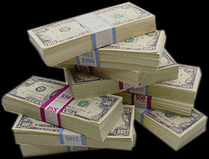
Types of Punishment-Misdemeanors
Incarceration/Prison: lasting usually no longer than 12 months Sometimes even part time imprisonment, weekend stays, etc..
Community Service
Fines
Probation: a suspended jail sentence for the convicted to be rehabilitated by the community

Slide 11
Juvenile Court System
Used for Minors (there are exceptions)
Focus is on rehabilitation. We want to give kids a chance to change their behavior.

Slide 12
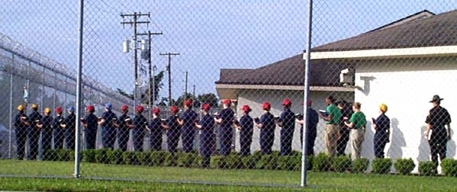
Types of Punishment- Minors
Juvenile Detention: prison for kids
Boot Camp programs instill discipline, education, and civic responsibility in youth offenders.
Probation
Community Service
House Arrest

Slide 13
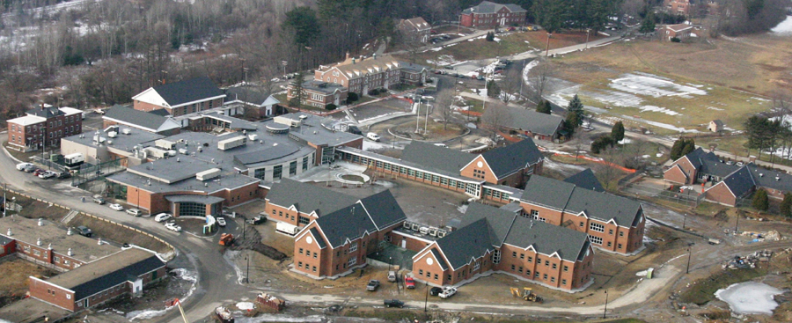
Juveniles in North Carolina
Once you turn 16 you are no longer a juvenile in the court system, unless the state makes an exception in your case.
Kids as young as 13 in NC can be tried as adults for serious felonies like 1st Degree murder.
Once you are tried as an adult, you will always be considered an adult in the NC court system.
If you are tried as an adult and sentenced you will be placed in an adult correctional facility. You will be with other youth offenders in that facility.

Slide 14
Discuss
Why do you think the juvenile system is easier on crimes than the adult system? Do you think this makes sense?

Slide 15
Miscellaneous
Mentally Ill: if convicted & found to be mentally ill the offender may be sentenced to a mental institution
3 strike laws: mandate long-term incarceration for person convicted of 3 or more felonies.
Parole: the supervised release of a prisoner before his/her sentence is finished.

