Slide 1
DO NOW Copy these terms down in your notes
Conflict Resolution Vocab
Negotiation: 2 sides discuss and come to settlement. Requires a compromise.
Compromise: agreement usually the middle ground between 2 or more sides.
Consensus: an agreement arrived at by a group of people and representing many opinions or an agreement by a group of adversaries (opposing sides).
Arbitration/Mediation: Alternative to going to court. Uses a professional mediator or a neutral 3rd party person to help you reach agreement. .

Slide 2
Ways for people to build consenus
Public Hearings: forum for the public to get information about different aspects (pros & cons) of a new policy.
Town Meetings: Public can go and voice opinions on a new proposed policy or gov’t action.
Community/Public Forums: Might be used for a certain issue (ex: Bond). A place where the public can go to get information

Slide 3
Notes
The Judicial Process is an Adversarial Process--> 2 sides present their versions of a case and a jury/judge determines the resolution.
Civil Case the 2 sides = Plaintiff & Defense
Punishments= Money awarded to winner for “damages”

Slide 4
Notes
Criminal Case-Crime against social order.
Criminal Law = Penal Law
2 sides = Prosecution & Defense.
Felony- committing a major crime resulting in a harsh punishment. Robbery, Grand Theft Auto, Drug sales
Misdemeanor- committing a minor crime usually resulting a weaker punishment (fine or community service). Disorderly Conduct, trespassing, vandalism.
Jury verdicts must be unanimous
Punishments: prison, community service, probation mandatory sentencing, death

Slide 5
Civil vs. Criminal
Brian Bates a 19 year old male was shot during a robbery at the McDonalds on Bickett Boulevard in Louisburg. Brian’s parents decide to sue the company that made the gun (Remington)for damages. The state of North Carolina also presses charges against Roberta Rogers the 34 year old robber for armed robbery and assault w/a firearm.
CIVIL CASE: _________ vs. _________
Who are the Plaintiffs?
Who are the Defendants?
Who do you think should win? Why
CRIMINAL CASE: ____________ vs. ____________
Who is the defendant?
Who is the prosecution?
Who do you think should win? Why

Slide 6
Civil or Criminal?
Slip and fall in a wal-mart because there is not “wet floor” sign.
Steal a Plasma TV from a Wal-Mart
Try to get sole custody of your children
Say something that is untrue about someone and ruin their reputation.
Kill a pedestrian in a crosswalk when you run a red light

Slide 7
Notes: Courtroom Vocab
Probable Cause: what the prosecution must have to get a warrant for investigation.
Plea Bargain: negotiation btw the prosecution and the defense to shorten court proceedings.
Prosecution might make a deal to reduce the sentence if the suspect pleads guilty and/or if he testifies against others.
Perjury: lying under oath
“Burden of Proof:” it is the prosecution’s job to prove that the defendant is guilty beyond a “reasonable doubt.”
Hung Jury: When the jury cannot reach a unanimous verdict →Mistrial

Slide 8
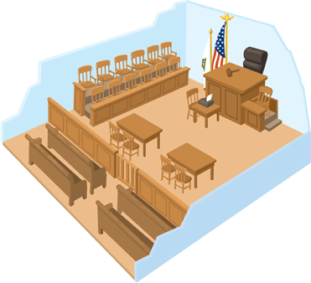
Courtroom Layout

Slide 9
NOTES: The steps of a Criminal Trial A.P.I.A.T.S.
A rrest
P reliminary hearing
I ndictment
A rraignment
T rial
S entencing

Slide 10
How I can remember APIATS
Always Play In A Toy Store

Slide 11
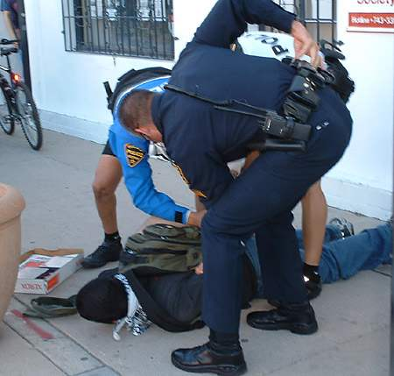
Arrest
Miranda Rights are read to suspect
Booking (fingerprints & mug shot)
REVIEW:
Which US Supreme Court case gave us the line “you have the right to an attorney…”
“You have the right to remain silent. Anything you say or do may be used against you in a court of law..”

Slide 12
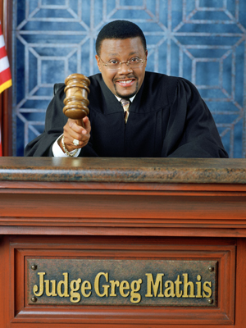
Preliminary Hearing
Judge informs suspect of the crime
Bail is set to ensure the suspect returns to court
REVIEW: Which amendment protects us from excessive bails?
“You are being charged with murder in the first degree. Bail is set at $800,000.”

Slide 13
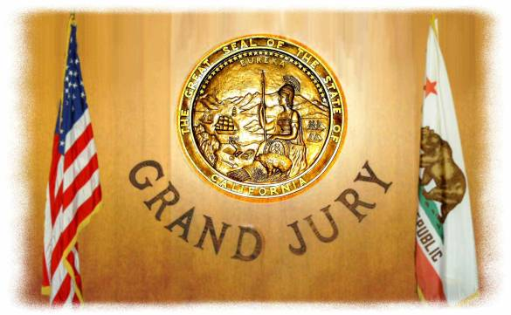
Indictment (pronounced: in-dite-ment)
Grand Jury decides if enough evidence exists for a trial to take place
Defendant is formally charged with crime.
“The Grand Jury indicted on 3 counts of assault”

Slide 14
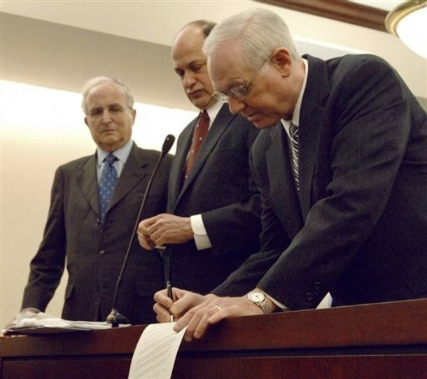
Arraignment
Defendant pleads Guilty or Not Guilty
“I plead guilty to the charge ”

Slide 15
Trial
Opening statements
Direct Examination
Cross Examination (question other sides’ witnesses)
Jury comes to a verdict: guilty (convict) or not guilty (acquit)
REVIEW: Which Amendment protects your right to an Attorney? Which US Supreme Court case forced the confirmed your right to an attorney?

Slide 16
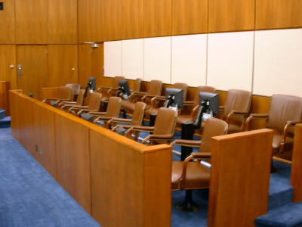
Jury deliberates.
Verdict must be unanimous
What does it mean if there is a hung jury?

Slide 17
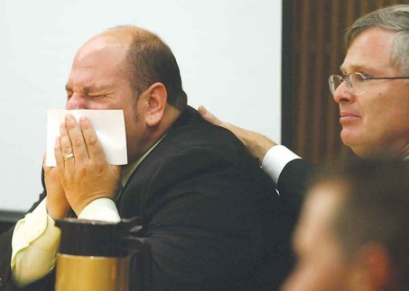
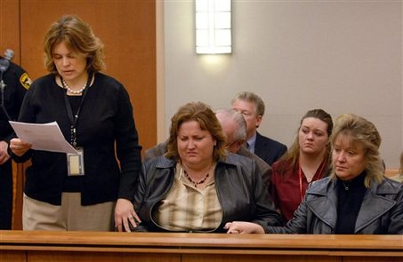
“The jury finds you guilty on the charge of murder in the first degree.”
Who decides the verdict? The Judge or the Jury?

Slide 18
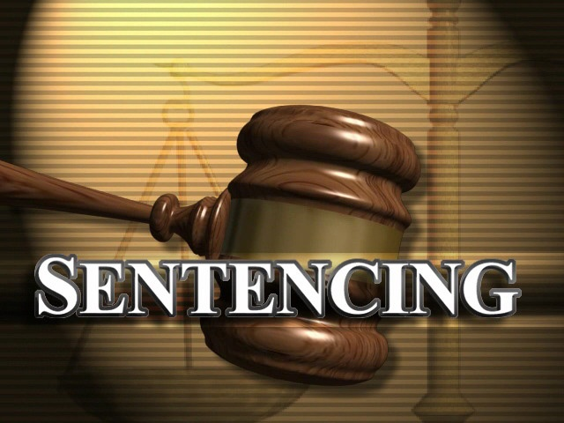
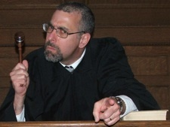
Sentencing (if guilty)
Jury decides punishment that matches the crime
Judge can reduce the sentence if necessary
“On the charge of murder in the first degree, I hereby sentence you to life in prison, without parole”

