Slide 1
Demand

Slide 2
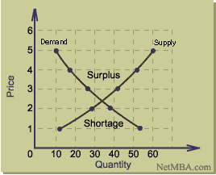
Predict
What happens to the quantity demanded as price goes UP?
What happens to the quantity demanded as the price goes DOWN?
Price | Units Demanded | Units Supplied
$5 | 10 | 60
$4 | 18 | 51
$3 | 28 | 41
$2 | 38 | 29
$1 | 52 | 10
Notes:
2

Slide 3
Demand Curve
As price increases, quantity demanded decreases
Price
D1
Quantity
Notes:
3

Slide 4
Demand Schedule
Demand: measures how much people are going to buy at the various prices.
Ex. Pizza Demand Schedule.
How many pizzas are people willing to buy at $1.50?
As the price of pizza increased what happened to demand?
Price
Quantity
$.50
8
$1.00
7
$1.50
5
$2.00
2
$2.50
1
Notes:
4

Slide 5
Law of Demand “The UP and Down”
As price goes up quantity goes down
As price goes down quantity goes up
People buy less goods/services at higher prices then they do at lower prices.
Notes:
5

Slide 6
If there was an increase in demand for CDs what would that mean?
If there was an decrease in demand for CDs what would that mean?

Slide 7
Illustration of Demand Shift
Increase in Demand = curve shifts to the right
Decrease in Demand = curve shifts to the left.
Price
Price
D1
D2
D2
D1
Quantity
Quantity
The less you buy the more you will move to the left!
Notes:
7

Slide 8
Why does demand shift?
Demand can increase (move right) and Decrease (move left) depending on certain conditions in the market.
There are 6 factors affecting demand
Notes:
8

Slide 9
Demand Factors
1. Consumer Disposable income: income left over after necessities are purchased. More $$ to spend on luxuries increases demand for them.
Example: If US Gov’t gave citizens a tax credit ($$$) then people would have more money to spend (more disposable income). Would demand increase or decrease?

Slide 10
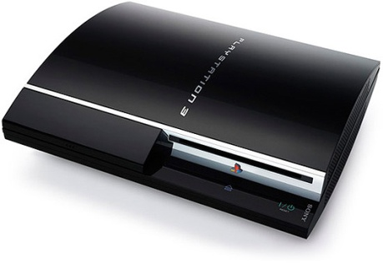
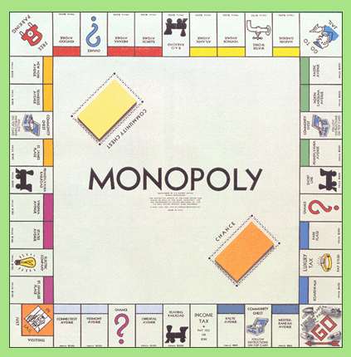
Demand Factors
2. Consumer tastes: popularity of a product
Example: Consumers who used to prefer board games now prefer video games. What happened to demand for board games?__________

Slide 11
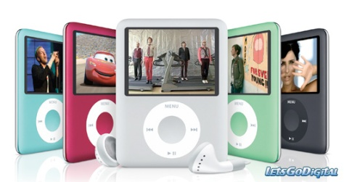
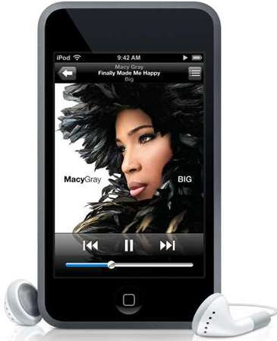
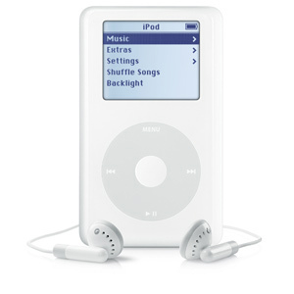
Demand Factors
3. Consumer expectations: what consumers expect to happen in the future
Example: Consumers expect that a new version of the iPod will come out around Christmas. What happened to demand for the OLD iPod?

Slide 12
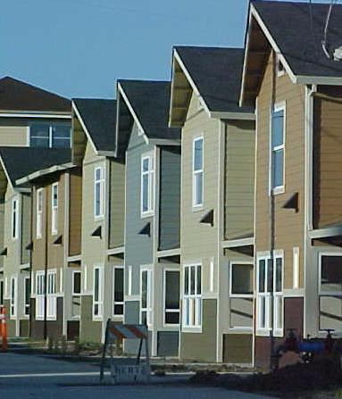
Demand Factors
4. Number of consumers: how many people live in a certain area
Example: A new housing development was built in Louisburg. Did the number of consumers in Louisburg increase or decrease? So what happened to demand?

Slide 13
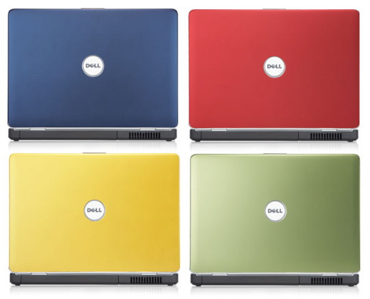
Demand Factors
5. Substitutes: competing products that can be exchanged when the price of one becomes too high. Honda & Toyota
Example: Dell raised the price of its laptops, so consumers started to buy the lower priced Sony laptop. What happened to demand for Dell laptops?

Slide 14
6. Complementary goods: Products that are used together.
Example: DVD players have become popular among consumers. What happened to demand for DVDs?

Slide 15
Fun with demand shifts!

Slide 16
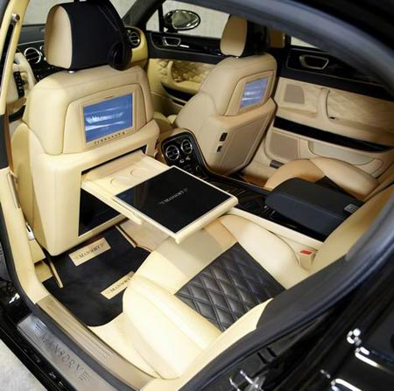
Fun with Demand Shifts!
1.
Scenario | Demand Factor | Increase or Decrease? | Graph
Because of a booming economy there was a rise in disposable incomes
Notes:
16

Slide 17
2.
Scenario | Demand Factor | Increase or Decrease? | Graph
The price of coffee is rising causing people to want to drink more tea instead, b/c tea is cheaper
Notes:
17

Slide 18
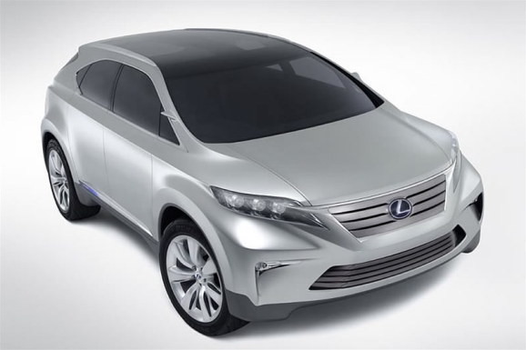
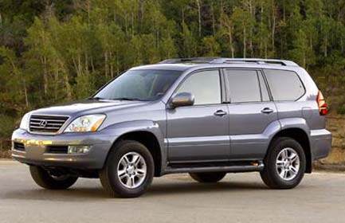
3.
Scenario | Demand Factor | Increase or Decrease? | Graph
Consumers expect that a new more fuel efficient SUV will come out and so they stop buying normal SUVs
Notes:
18

Slide 19
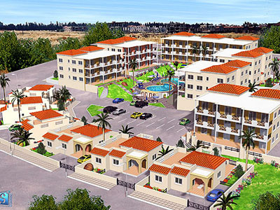
4.
Scenario | Demand Factor | Increase or Decrease? | Graph
The number of consumers in Franklin County grew when an apartment complex was built
Notes:
19

Slide 20
5.
Scenario | Demand Factor | Increase or Decrease? | Graph
The popularity of beanie babies has declined as consumers decide to purchase higher technology toys
Notes:
20

Slide 21
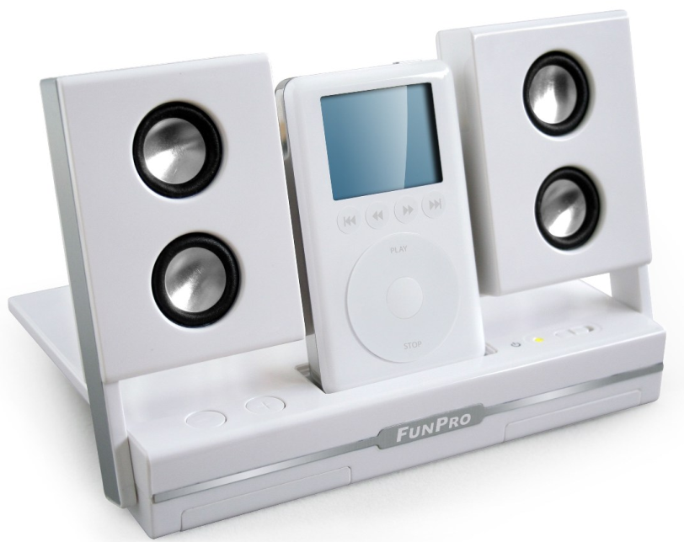
6.
Scenario | Demand Factor | Increase or Decrease? | Graph
The popularity of iPods has led to consumer demand for iPod speakers and iTrip
Notes:
21

Slide 22
7&8
With a partner write a demand shift scenario.
Make sure you know what the “demand factor” is, whether demand increased or decreased and how to draw the graph.
Switch your scenario with another pair.
You will write your answer on the plastic with a dry erase marker
Check their answer
Repeat for # 8
Notes:
22

