Slide 1
CE Notes 23-24
Constitutional
Amendments!

Slide 2
How to Amend!
The process for amending the Constitution is stated in Article IV (4) of the US Constitution.

Slide 3
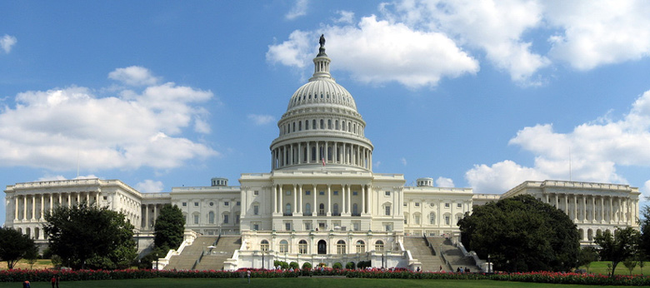
Pg. 23 To PROPOSE an Amendment:
By 2/3 vote in both the House and the Senate
2/3
2/3

Slide 4
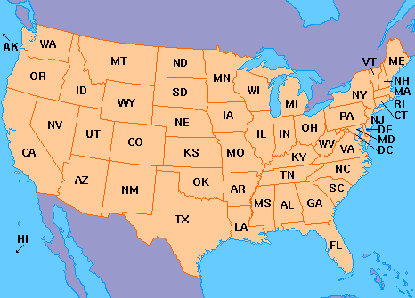
Pg. 23 To RATIFY an Amendment:
¾ of the state legislatures
FYI: That would mean at least 38 out of 50 States would have to approve the Amendment for the Constitution to be changed.
¾

Slide 5
Does it become an amendment if… yes or no
Only 1/3 of the House and 1/3 of the Senate vote to propose the Amendment?______
2/3 of the House proposes the Amendment, but only 1/3 of the Senate votes to propose an Amendment? ______
2/3 of the House and Senate propose, but only ¼ of the state legislatures ratify?____
2/3 of the House and Senate propose and ¾ of the state legislatures ratify?_____
2/3 of the House and Senate ratify and the President signs the Amendment?____

Slide 6
Warm Up
Mrs. Edwards
9-25-13
What rights of the accused does the 5th amendment provide?
Why is the 8th amendment so controversial?
How does the 4th amendment protect Americas citizens?

Slide 7
Put on the Amendments 11-27 handout
AMENDMENTS
Amendment 11: Supreme court will hear law suits between states
Amendment 12: If there is a tie in the electoral college the House picks the President and the Senate picks the VP.

Slide 8
Notes 24
Amendments 13-15 were ratified following the Civil War
Amendment 13: Ends Slavery
Amendment 14: Gives all citizens “Equal Protection Under the Laws,” this is later used to end segregation.
Amendment 15: Gives ALL Men the right to vote “Suffrage”, even former slaves.

Slide 9
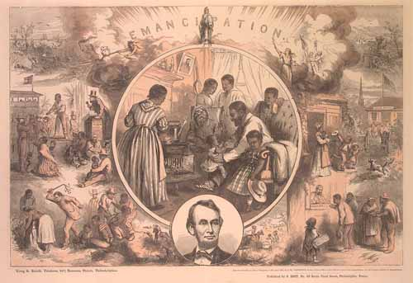
________Amendment
Ended slavery in the United States

Slide 10
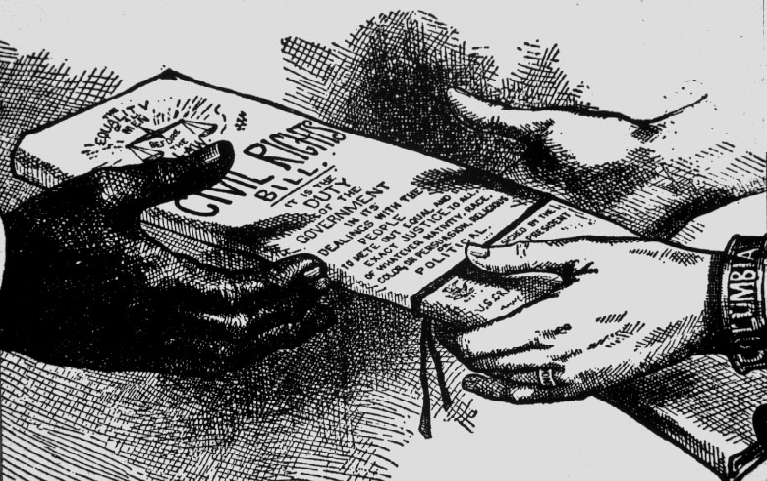
______ Amendment
Equal protection under the law
Everyone must be treated equally
Everyone is a citizen of the US
Applied the Bill of Rights to the States

Slide 11
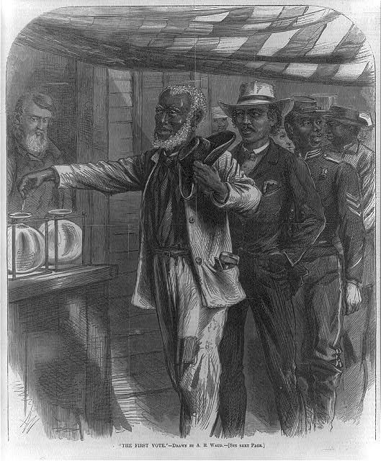
_______Amendment
Cannot be denied the right to vote based on race, or previous condition of servitude
All men can vote

Slide 12
Notes 24
Amendment 16: Congress can collect the Income Tax
Amendment 17: Senators will now be elected by people in each state and NOT by the state legislatures
Amendment 18: Prohibition/Volstead Act--Prohibits the sale or use of Alcohol
Amendment 19: Women’s Suffrage (get the right to vote in 1920)

Slide 13
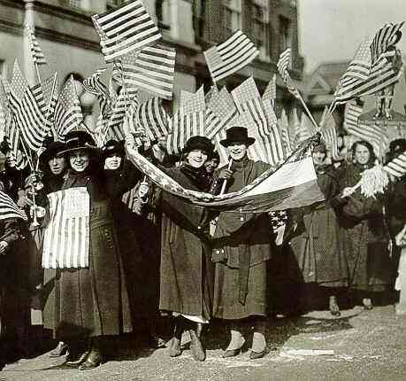
________Amendment
Women gain suffrage (right to vote)

Slide 14
Notes 24
Amendment 20: Moves up the Presidential inauguration Jan 20 instead of March.
Amendment 21: Repeals the 18th Amendment and allows the sale and consumption of alcohol.
Amendment 22: Presidents can only serve 2 terms in office (Max 10 yrs)
Amendment 23: Washington DC now gets to have 3 representatives/Electors in the Electoral College.

Slide 15
Notes 20
Amendment 24: Prohibits the use of a poll tax (tax you have to pay to vote)
Amendment 25: Presidential succession: If the president dies, the vice president becomes president.
Amendment 26: Makes 18 the national voting age
Amendment 27: Prevents Congress from raising its pay before the end of their term.
If they raise their pay, it only goes into effect after an election.

Slide 16
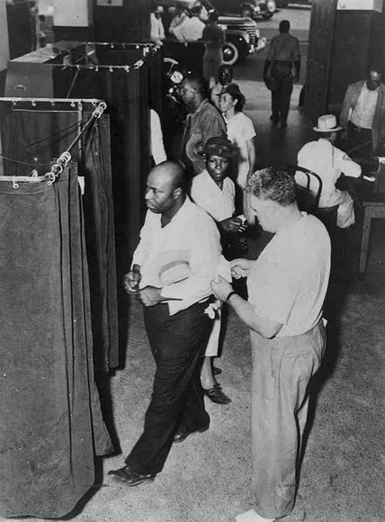
_________ Amendment
No poll taxes
Cannot be forced to pay a fee in order to vote

Slide 17
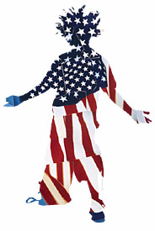
_________Amendment
All citizens 18 years of age and older have the right to vote

