Slide 1
CE-Notes 77-78 Factors of Production

Slide 2
Factors of Production Goal 7
Labor
Capital
Entrepreneurship
Land
Notes:
2

Slide 3
RAP 77
What went into the production of the candy bar I gave you yesterday?
Notes:
3

Slide 4
NOTES 78
Production: Creation of goods/services
Productivity: measures how much a business produces of each good or service per each worker employed.
EX: How many hamburgers can each worker at McDonalds produce?
Total hamburgers / number of workers = Productivity
A) 100 hamburgers / 10 workers = ______
B) 100 hamburgers / 5 workers = _______
Productivity comparison: Which McDonalds would you want to own, A or B? Why?
Notes:
4

Slide 5
Efficiency: how much does it cost to produce each good or service
Ex: How much does it cost to make each hamburger?
Total cost of hamburgers / # produced= Efficiency
$100 for all hamburgers / 100 Hamburgers = _______
$200 for all hamburgers / 100 Hamburgers =_______
Efficiency Comparison→Which McDonalds do you want to own, A or B? Why?

Slide 6
Productivity and Efficiency
Producers want to maximize their productivity and efficiency in order to make a larger profit!
So, you want to get the MOST out of every worker and resource you can.
We know a business is efficient when the cost of producing a resource is not more than the price.
Example: It cost me $1 to make each burger and I can sell it for $2! What is my profit on each burger?
Notes:
6

Slide 7
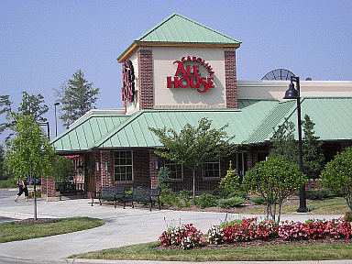
Thinking about productivity and efficiency:
Imagine you own a restaurant.
Should you hire A LOT of extra staff or just the exact number of people you need to run the restaurant?
What would happen if there were TOO many people?
What would happen if there were TOO few people?
What type of workers should you hire for your restaurant (think about qualities of good workers)?
Should you buy a lot of extra food or just want you need to meet the demand from customers?
What would happen if there was EXTRA food?
What would happen if you didn’t have enough food?

Slide 8
Factors of Production
ALL FOUR FACTORS MUST BE PRESENT TO PRODUCE ANY GOOD/SERVICE!
Land
Labor
Capital
Entrepreneurship
Notes:
8

Slide 9
Land
Adds natural resources necessary for production these are renewable and nonrenewable resources
Renewable Resources: trees, oxygen, water
Non-Renewable Resources: gold, oil, coal, gas
ANSWER: What is the difference between a renewable and nonrenewable resource?
Notes:
9

Slide 10
Which explains the need to protect natural resources?
Global warming is a direct result of using renewable energy.
Focusing on renewable energy sources will help the environment.
Nonrenewable energy sources can be sustained for thousands of years.
New oil production facilities will increase our ability to transport people.

Slide 11
Labor (workers)
Labor is the nation’s workforce or human resources. Sometimes it is called human capital.
It includes the physical and mental talents of the people who help produce goods and services.
Factors such as population growth, education, training and war affect the quantity and quality of labor.
Notes:
11

Slide 12
Capital
Capital, or capital goods, includes the tools, machinery, and buildings used to make other products.
Financial Capital is the money that goes into a new business
Consumer goods satisfy wants directly; capital goods do so indirectly by aiding production of consumer goods.
Notes:
12

Slide 13
Question
How are capital goods different from consumer goods?
Notes:
13

Slide 14
Answer/Suggestions
How are capital goods different from consumer goods?
Capital goods satisfy wants indirectly. They are the tools, machinery, and buildings used to produce consumer goods.
Notes:
14

Slide 15
Entrepreneurs
Entrepreneurs are individuals who start new businesses, introduce new products, create jobs and improve management techniques.
They are innovative and willing to take risks.
Brains of the economy: Entrepreneurs drive the economy because they use factors of production to produce new products & create jobs.
Notes:
15

Slide 16
Candy Bar
→So what factors of production go into the making/selling of a candy bar ?
Land
Labor
Capital
Entrepreneurship

Slide 17
ABCD
Which is a result of using factors of production in an efficient and cost effective manner?
Investment
labor
productivity
scarcity

Slide 18
PIT 69
Create your own product
Complete the table about how you will combine all 4 factors of production.
Notes:
18

Slide 19
Exit Ticket
Complete the 4 factors chart of a pair of jeans
Land
Labor
Capital
Entrepreneurship
Notes:
19

Slide 20
For the following pictures tell me whether which factor of production they represent.
A: land
B: labor
C: capital
D: entrepreneurship

Slide 21
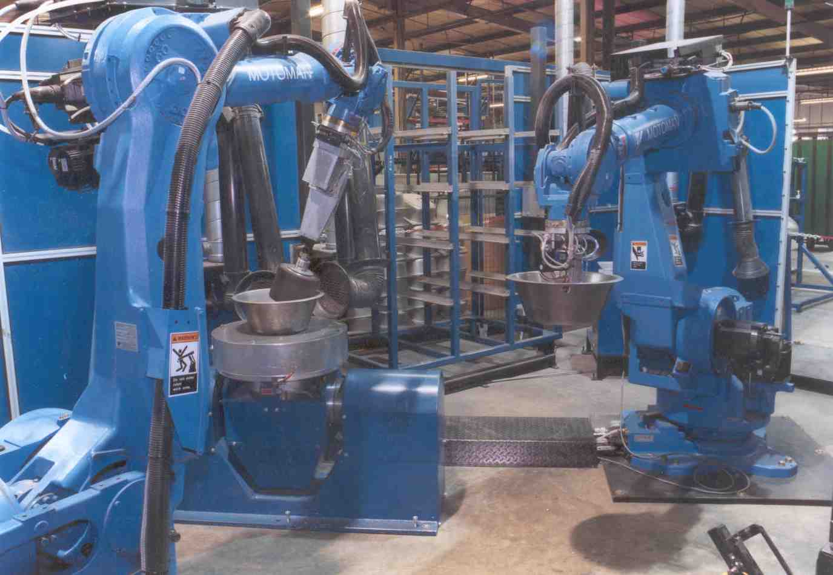
1. Capital
Notes:
21

Slide 22
2. Land/Resource →Is the renewable or non-renewable?
Notes:
22

Slide 23
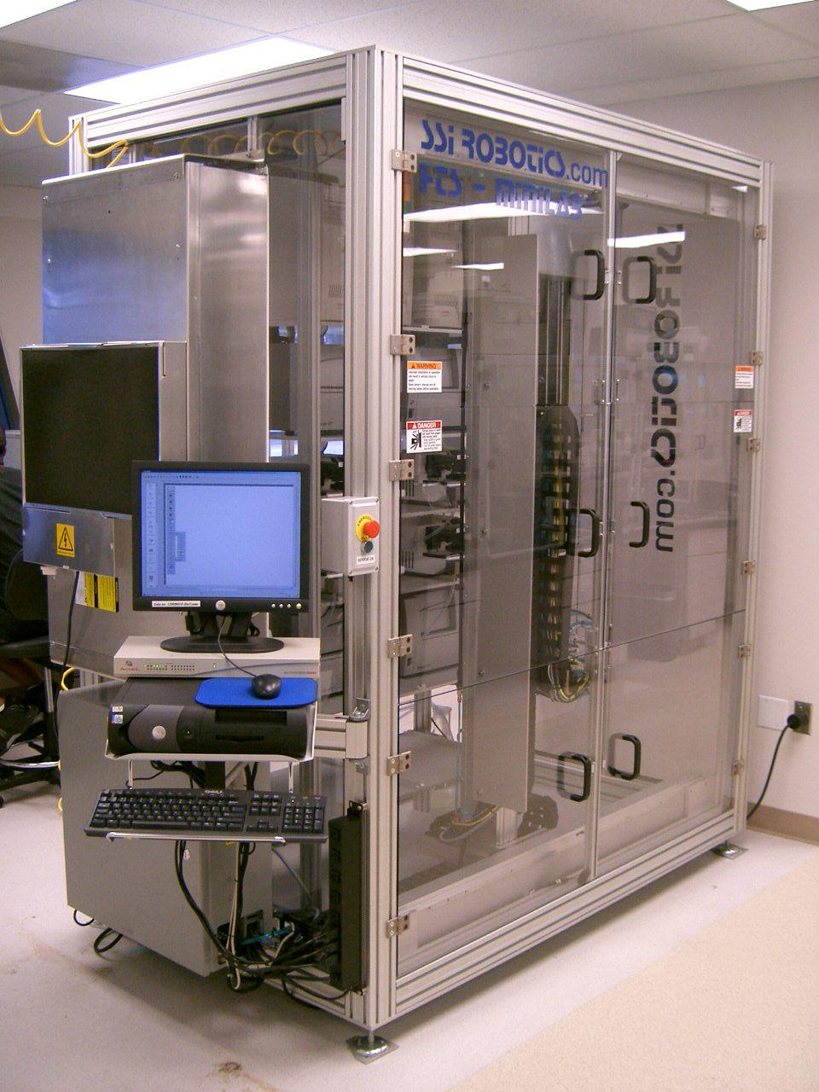
3. Capital
Notes:
23

Slide 24
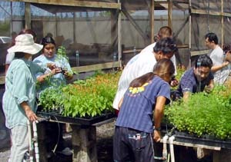
4. Labor
Notes:
24

Slide 25
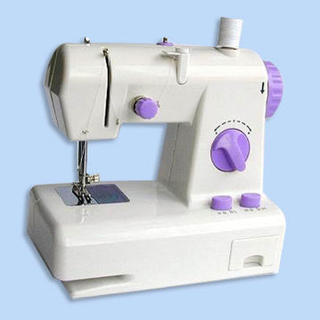
5. Capital
Notes:
25

Slide 26
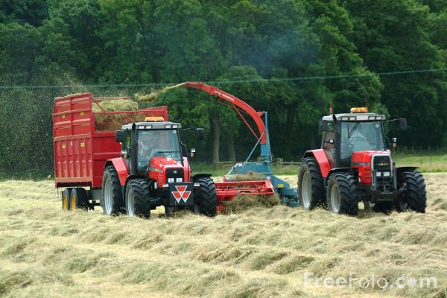
6.
A)
B)

Slide 27
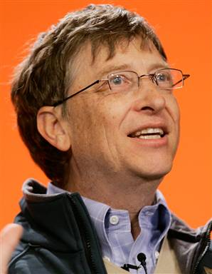
7. Entrepreneurship
Notes:
27

Slide 28
8. Land/Resource
Notes:
28

Slide 29
10. Labor
Notes:
29

Slide 30
Land/Resource: renewable or nonrenewable??
Notes:
30

Slide 31
12. Entrepreneurship
Notes:
31

Slide 32
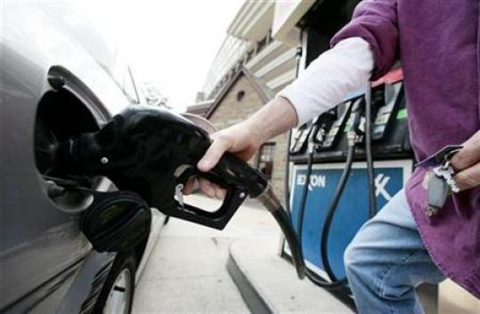
12. Land/Non-Renewable or renewable?
Notes:
32

Slide 33
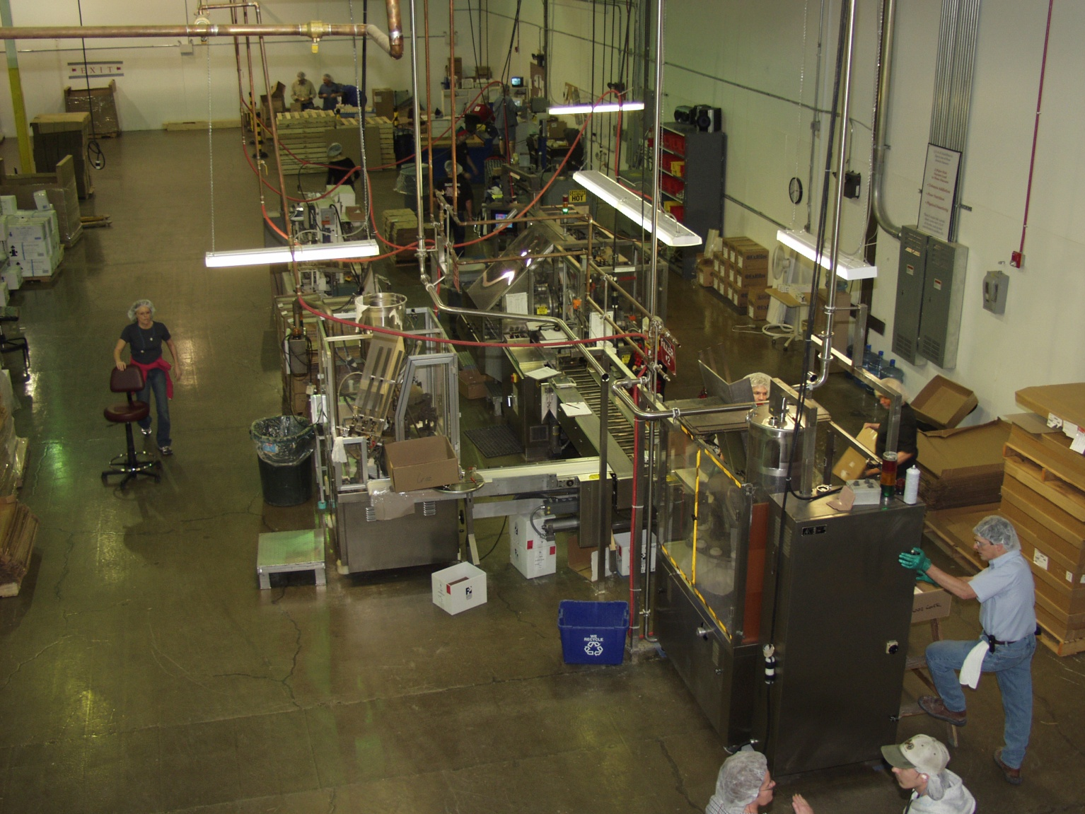
13. Capital
Notes:
33

