Slide 1
CE-Notes 71-72 Law Enforcement

Slide 2
Objectives
SWBAT compare responsibilities, jurisdictions, and methods of law enforcement agencies.

Slide 3
All Law enforcement agencies are under the Executive Branch of city, county, state or federal government.
Department of Justice (DOJ): Enforces Federal Law and oversees all federal law enforcement agencies except the CIA and Secret Service.
The Attorney General is the head of the DOJ & part of the President’s cabinet

Slide 4
Purpose of federal agencies: each has specialized skills which can help to enforce laws.
Ex: the DEA (drug enforcement administration) has agents specialized in preventing drug trafficking.

Slide 5
Federal Bureau of Investigation (FBI):
Jurisdiction: Federal
Function: investigates all federal crimes in the US
Examples: crimes crossing state lines, investigating terrorist threats within the US

Slide 6
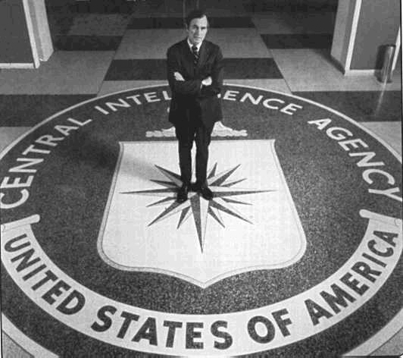
National Security
Central Intelligence Agency (CIA):
Jurisdiction: Federal
Function: responsible for the USA’s national security. Investigates international threats.
Ex: gets information on terrorists in other countries

Slide 7
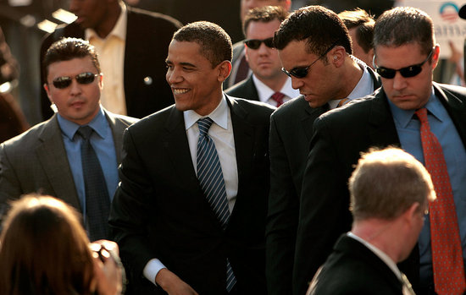
Secret Service:
Jurisdiction: Federal
Function: Protects the Pres. & VP. Investigates $$ counterfeiting.
Ex: president’s security guards

Slide 8
State Bureau of Investigation (SBI):
Jurisdiction: State
Function: Assists local law enforcement in large criminal investigations.
Ex: investigating a string of bank robberies across the state

Slide 9
State Troopers:
Jurisdiction: State
Function: Enforce traffic laws on state highways.
Ex: monitor speed on roads like I-85

Slide 10
County Jurisdiction:
Sheriff:
Jurisdiction: County
Function: enforces laws in both the incorporated and unincorporated areas of the county.
Ex: Sheriff is responsible for courthouse security

Slide 11
City/Town Jurisdiction
Police:
Jurisdiction: City/Town
Function: enforces city laws & ordinances
Ex: make an arrest following robbery

