Slide 1
Marbury v. Madison
The first ever Supreme Court case

Slide 2
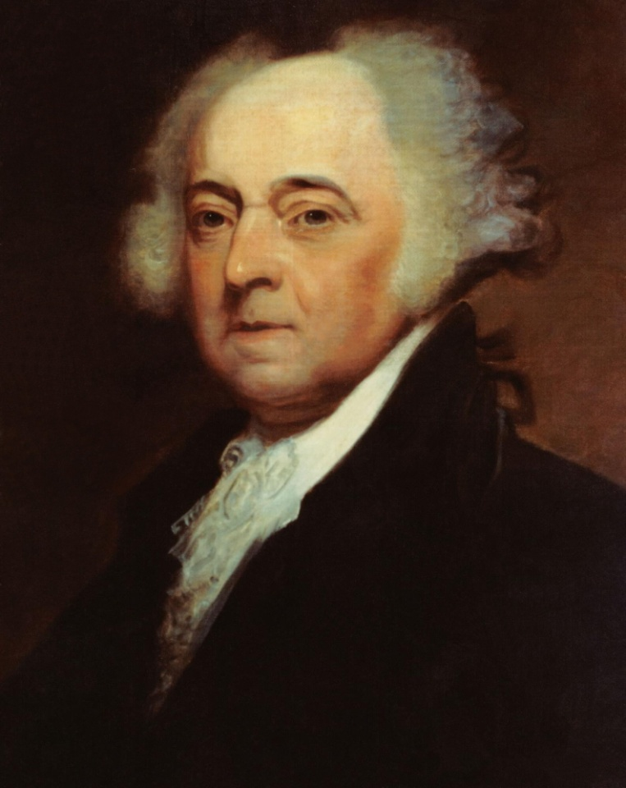
Background Information
In 1880, John Adams was president. He was a Federalist
It was an election year, and he lost his re-election to Thomas Jefferson who was in an opposing political party (Democratic Republicans)
Before Adams left office he tried to fill jobs with people who were in his own party. He appointed 58 people.

Slide 3
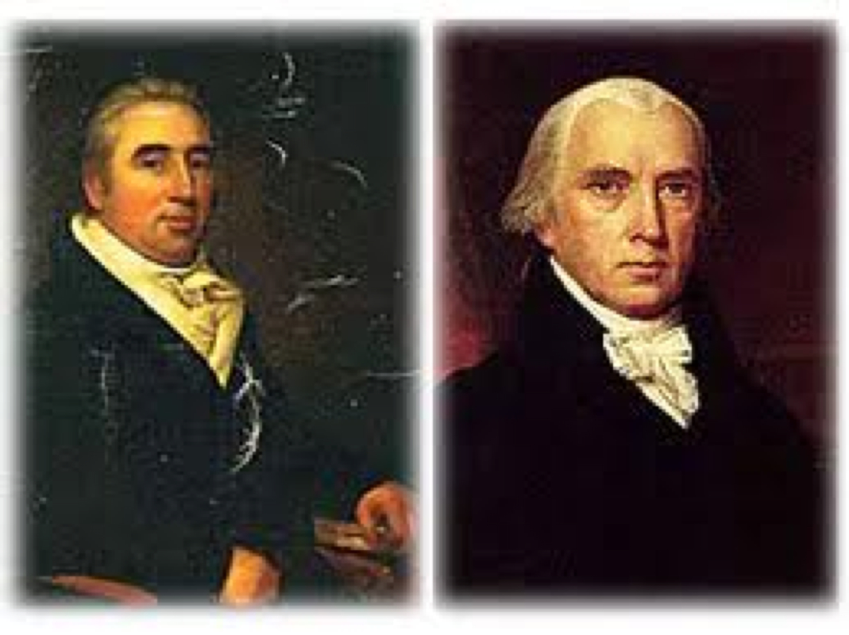
Background Information
Adams asked his Secretary of State, John Marshall, to deliver the paperwork to these people so they could start their new jobs.
Marshall left some of the papers for the new Secretary of State, James Madison, to deliver.
President Thomas Jefferson told Madison not to deliver the papers to some of the people Adams had appointed.
William Marbury was supposed to receive papers, but did not. Marbury sues Madison

Slide 4
Supreme Court’s Decision
If the Court required Madison to deliver the commission and Madison refused, the Court had no power to force him to comply, and, therefore the Court would look weak.
If the Court did not act, it would look like the justices made their decision out of the fear that Madison would not obey their decision.
The Court unanimously decided not to require Madison to deliver the commission to Marbury.
This decision established the judicial branch as an equal partner with the executive and legislative branches

Slide 5
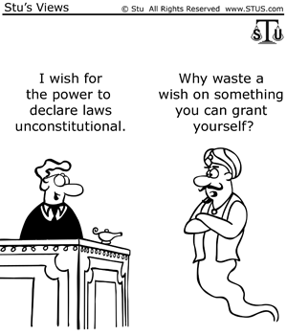
Impact of the Decision
“It is the job of judges, including the justices of the Supreme Court, to interpret laws and determine when they conflict with the Constitution. According to the Court, the Constitution gives the judicial branch the power to strike down laws passed by Congress, the legislative branch”
(http://www.streetlaw.org/en/Page/292/Summary_of_the_Decision)

Slide 6
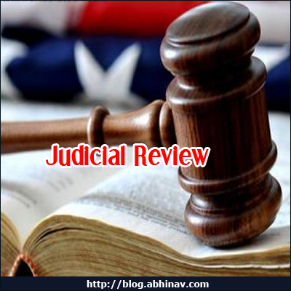
Amendment/Principle
This established the principle of Judicial Review for the United States
This case deals with a principle instead of an amendment
Now the Supreme Court can hear cases that violate people’s constitutional rights.
They have the power to change laws

Slide 7
Connection to Current Events
The U.S. Supreme Court is currently hearing cases regarding same sex marriage. They used their judicial review to determine that gay couple cannot be denied the right to marry in certain states.
“Same-sex couples across Alabama began marrying this morning, after the Supreme Court refused to put on hold a ruling by a federal judge invalidating the state’s ban on same-sex marriage. The high court’s move makes Alabama the 37th state where gay unions are legal.”
(http://www.newrepublic.com/article/121013/supreme-court-gay-marriage-alabama)

Slide 8
Connection to Current Events
SCOTUS overturns Alabama Courts

Slide 9
Sources
http://www.streetlaw.org/en/landmark.aspx
http://www.newrepublic.com/article/121013/supreme-court-gay-marriage-alabama
http://youtu.be/2cLO33XeYZE

