Slide 1
Elections
CEnotes 41-42
NC 4.04
Notes:
1

Slide 2
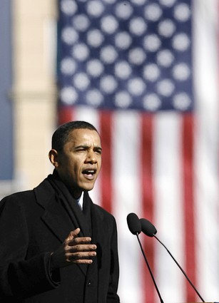
Notes
4-STEP PATH TO THE PRESIDENCY:
Announce candidacy: make it public that you are running and begin to build name recognition.
President Obama announced his candidacy in his home state of Illinois, where Abraham Lincoln made a famous speech about ending slavery.
Where would you announce your campaign?
Notes:
2

Slide 3
2. Primaries and Caucuses: Each state holds Republican and Democratic Primaries or caucuses.
Primary: election where you vote for your choice to represent the party in the general election (open or closed)
Caucus: meeting where you decide on who should represent the party in the general election.

Slide 4
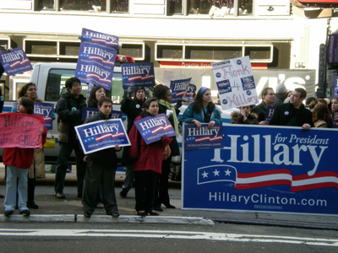
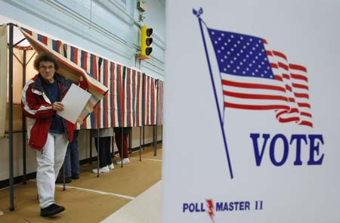
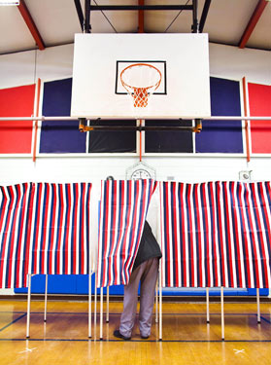
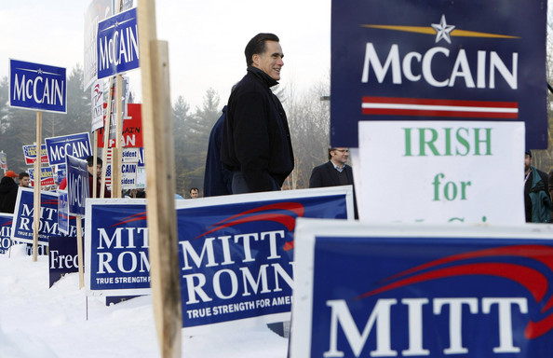
Primary
During a primary, people vote to pick the person from the party who they want to run in the general election.

Slide 5
Primaries can be open or closed. Open means all registered voters can participate. Closed means only party members can vote in primary.
Ex: The North Carolina primary is closed, this means that in order to participate voters must be registered with a certain party.
The New Hampshire primary is OPEN this means that it is open to all voters (R, D or independent)

Slide 6
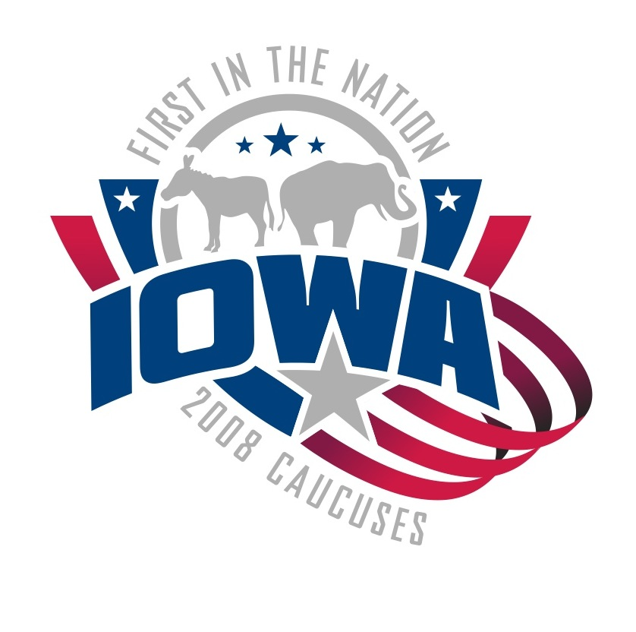
Caucus
In a caucus people MEET and discuss who they want to elect. There might be several votes.

Slide 7
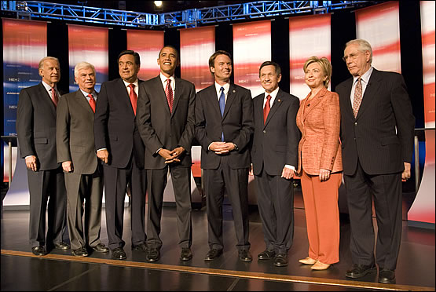
Democratic Primary Debate

Slide 8
Republican Primary Debate

Slide 9
3. National Convention: Delegates for each party report at the end of the summer. This is where each party officially announces their nominee for president.

Slide 10
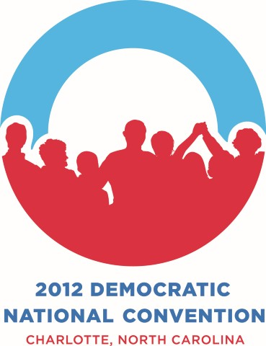
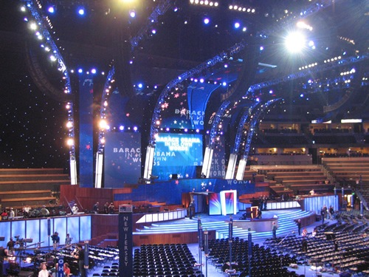
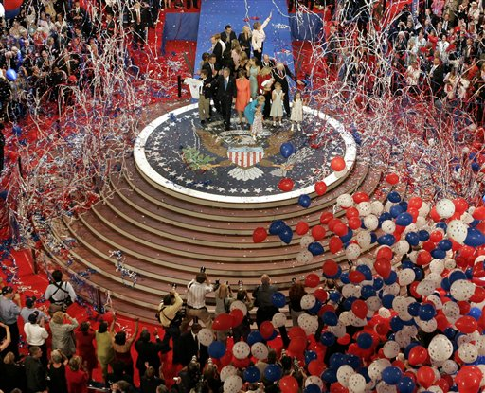
Conventions: Each party announces their national candidate for president.
Notes:
10

Slide 11
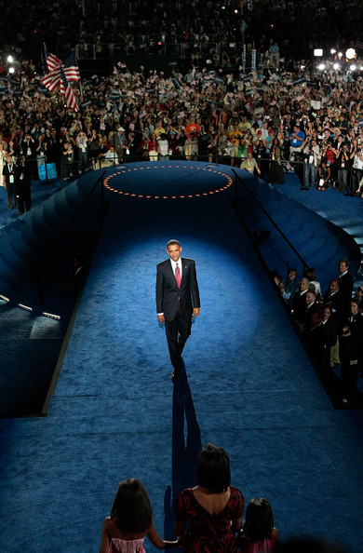
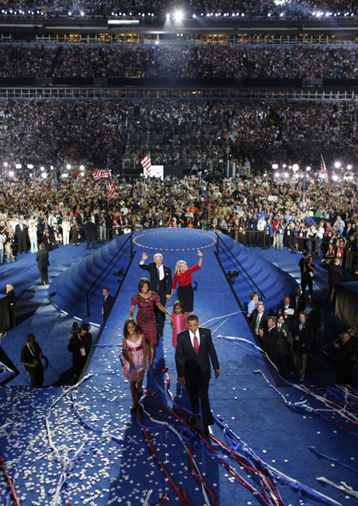

Slide 12
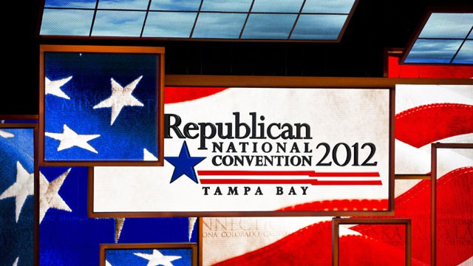
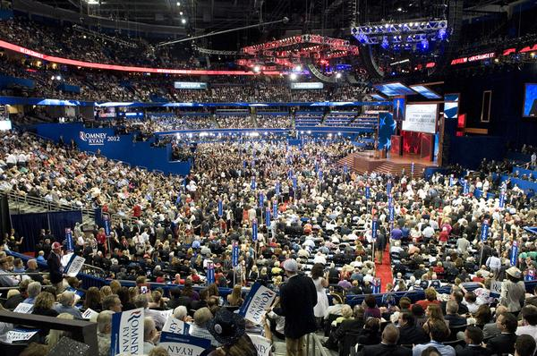
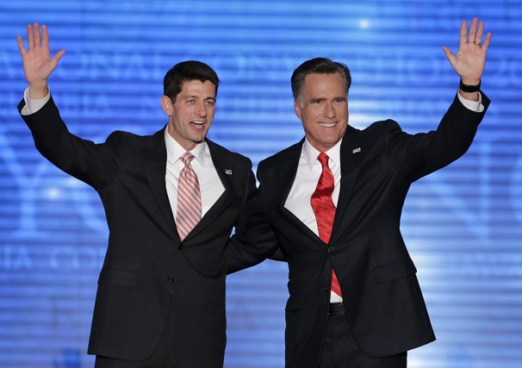
RNC 2012
Notes:
12

Slide 13
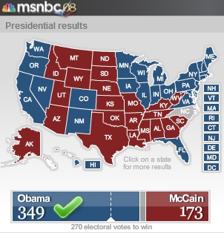
4. General Election: Tuesday following the first Monday in November. Big night where you must win those 270 electoral votes!

Slide 14
Notes :
During the General Election you can vote on a “split ticket” or a “straight ticket”
Split: voting for Dems and Reps.
Straight: just voting for ONE party
Notes:
14

Slide 15
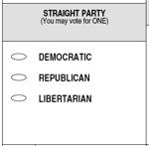
If I vote a “STRAIGHT” ticket I just fill in the circle next to the party I want to vote for.
Now everyone I voted for will be a….

Slide 16
If I vote a “split ticket” that means I will vote for some Democrats and some Republicans.

Slide 17
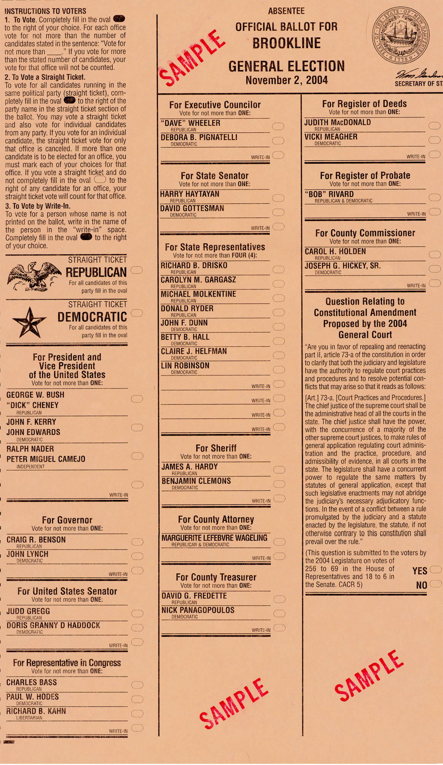

Slide 18
Answer!
Where does each party officially announce its candidate/nominee for the presidency?
What is the difference between the Primaries and the General Election?
In the Primaries you are choosing a candidate to represent your party. In the General Election you must pick between the 2 parties.

Slide 19
On the campaign trail…
Canvassing: where supporters go out and knock on doors and get people to vote.
Mass Media: (example: TV commercials) reach the most people and can do good or bad.
Retail Politics: REALLY meeting the voters and selling yourself.
Polls: determine where candidates campaign.
Debates: a chance to meet opponent face to face and argue the issues.
Notes:
19

Slide 20
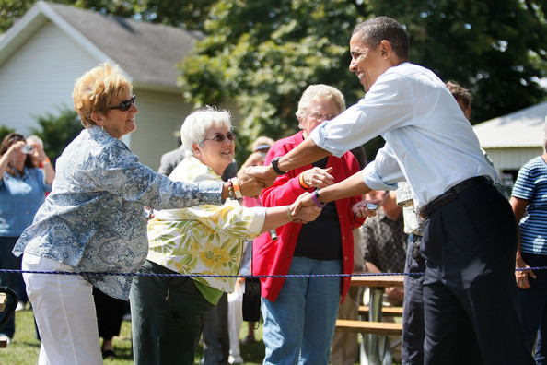
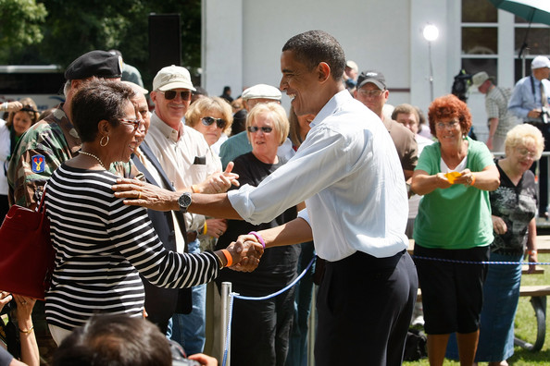
Retail politics: Sell Yourself!

Slide 21
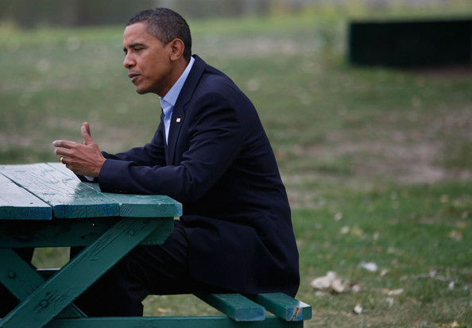
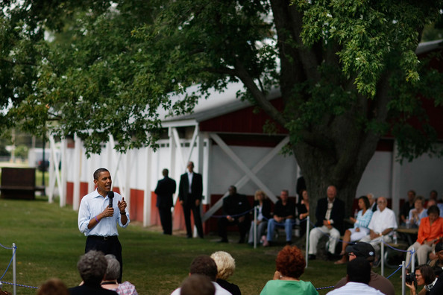
Use your plain folks appeal!

Slide 22
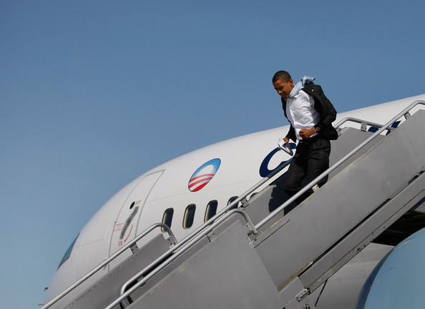
You’ll need a plane to get to all 50 states!

Slide 23
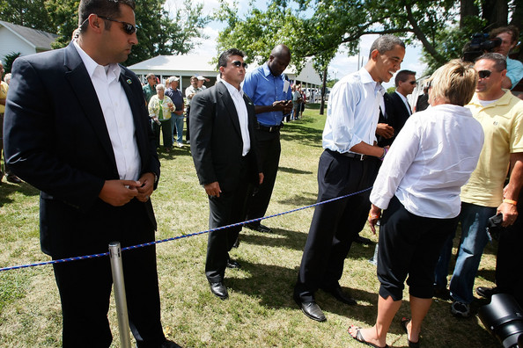
You’ll also need protection

Slide 24
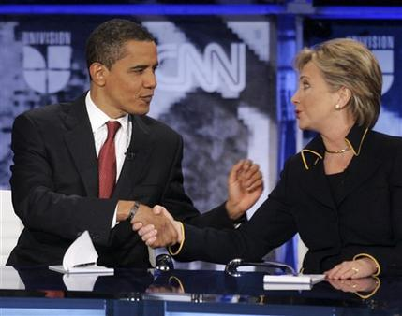
Debates: held during primaries and during the general election
What political party are both of these candidates from?
So was this debate during the primaries or the general election?
Notes:
24

Slide 25
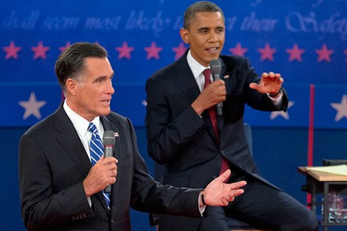
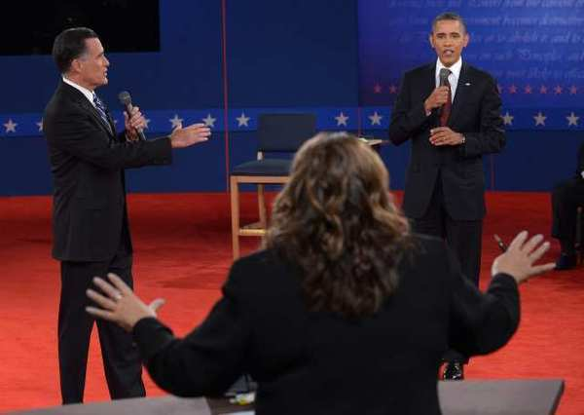
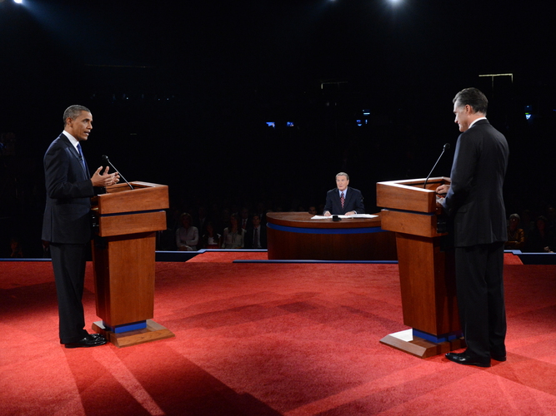
General Election Debates
What political parties are represented here?

Slide 26
Political Action Committee (PAC): raise $$ for candidates. Can be set up by the party or by business or special interests.
Special Interest groups: Ex=labor unions, religious groups, pro-life groups, pro-environment, pro-guns etc. Raise money & support for candidates who support their issues.

Slide 27
Electoral College

Slide 28
How we elect the president (Article II):
Electoral College: This body is used to elect the Pres/V.P.
Each state gets the # of representatives + # of Senators.
13 NC representatives + 2 NC Senators = 15 Electoral Votes
Winner Takes All: Whichever candidate wins the most popular votes in that state will receive ALL the electoral votes for the state (Except in Maine & Nebraska)
In 2008, McCain won 49% of the popular vote in NC. Barack Obama won 50% of the popular vote in NC. Who received NC’s Electoral Votes? How many did he win?
There are a total of 538 electoral votes
You must win 270 electoral votes to win
Notes:
28

Slide 29
Electoral College Cont’d
If there is a 269 to 269 vote tie the House decides the President and the Senate decides the VP (12th Amendment)

Slide 30
Electoral College Cont’d
Why did the framers of the Constitution decide to create the Electoral College?
Federalism: The Anti-Federalists wanted to make sure the states still had power in the federal gov’t. The Electoral College is designed so that even small states can influence the outcome of an election.
Example: President Obama had to campaign in big states like Ohio and Florida, but he also had to campaign in NH which only has 4 electoral votes so that he would have at least 270 total on election day.

Slide 31
Why we use the Electoral College.
2. Fear of a direct popular vote: The Federalists feared that a direct popular vote would be too much power in the hands of the people. They wanted electors to be able to make a thoughtful decision about who should be president.
Today Electors vote the way the people in their state want them to.

Slide 32
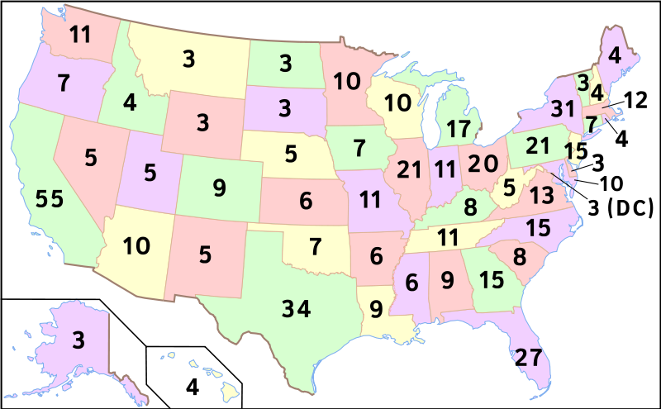
Electoral College Map
Notes:
32

Slide 33
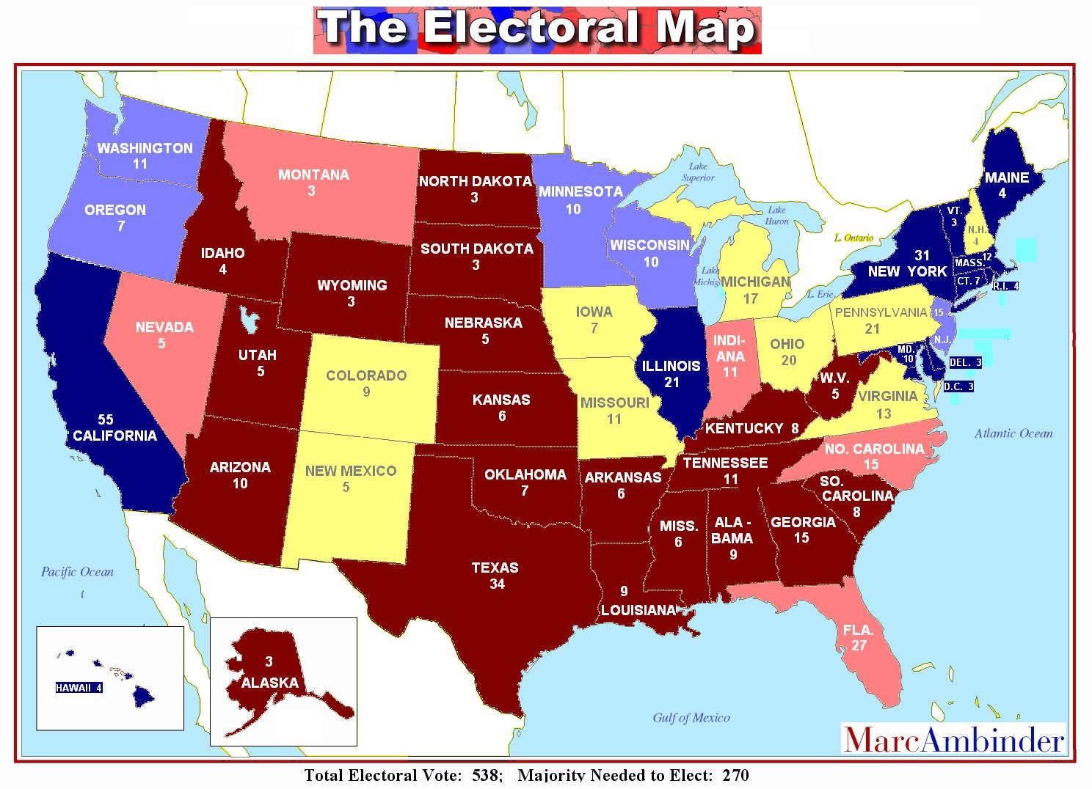
2008 Election Prediction
Blue = Dems 210
Red = Rep. 221
Toss-up = 123 votes

Slide 34
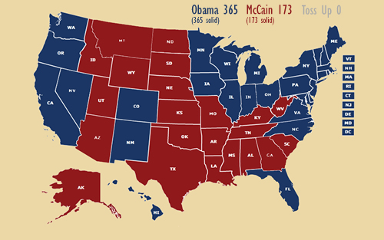
Final 2008 Election Results Obama: 365 Electoral Votes McCain: 173 Electoral Votes

Slide 35
Notes 26
Criticisms of the Electoral College:
Winner takes all is unfair.
Since all states have 2 Senators and at least 1 rep that unfairly gives the states with small populations too much influence.
Example: In Wyoming there are 170,000 people represented by each electoral vote. In California 670,000 people are represented by each electoral vote.
But then if small states didn’t have at least 3 electoral votes no candidate would ever pay attention to that state.
Do you think it is fair that 1 electoral vote can represent 700,000 people in one state and then only 200,000 people in another state?

Slide 36
Which 5 states have the most electoral votes (greatest to least)____________, ____________, ___________, ____________, ______________.
Which 7 states have the least electoral votes (least to greatest)? _____________, ____________, _________________, _______________, _______________.
During an election what does it mean when the media calls a state a “blue state” or a “red state”
Blue state:
Red state:
If you were running for president and polls showed that you were ahead by 20 percentage points in California and New York would you spend money campaigning there? Explain why or why not.
Do you think the winner-take all system is fair, why or why not?

Slide 37
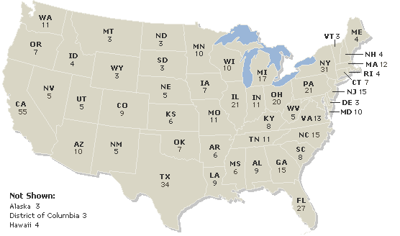
Electoral Map

Slide 39
EOC Practice
4. What is the purpose of a primary election?
to determine public opinion
to elect state and local officials
to determine each party’s candidate in the general election
to determine which political party will win the general election
Notes:
39

Slide 40
EOC Practice
Which of the following best describes the point where both the parties make their nominees to the presidency official?
Primary election
Declaration of candidacy
General election
National convention
Notes:
40

Slide 41
EOC Practice
6. What is the sequence of events during a presidential election year?
general election, primary election, votes cast in the Electoral College, national convention
national convention, primary election, votes cast in the Electoral College, general election
primary election, national convention, general election, votes cast in the Electoral College
votes cast in the Electoral College, primary election, national convention, general election
Notes:
41

Slide 42
EOC Practice
How are caucuses different from primaries?
Primaries can only be held in states after the initial caucus has taken place.
Primaries are used in large states where voters select candidates at the same time.
Caucuses do not have the power to designate a political candidate as a party's caucus winner.
Caucuses are informal gatherings of voters where discussions and support for candidates can be debated
Notes:
42

Slide 43
EOC Practice
9. Which of the following allows voters to choose candidates from either political party?
closed primary election
general election
primary election
Electoral college
Notes:
43

