Slide 1
Political Parties
Notes:
1

Slide 2
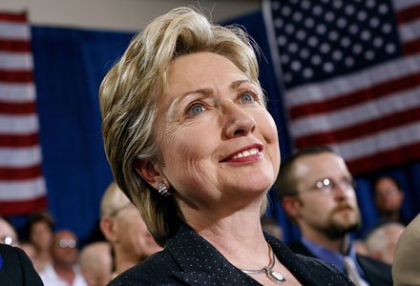
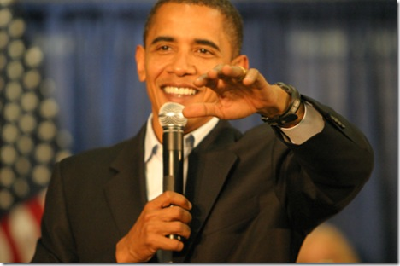
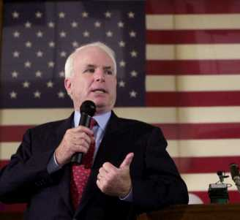
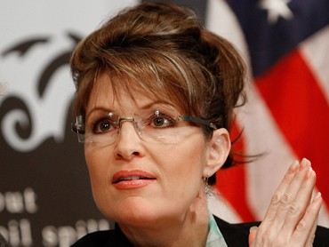
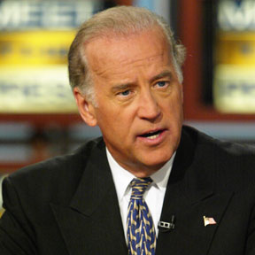
RAP 31
A
B
C
D
E
Match the letter of the picture with the politician’s name:__Sarah Palin __Barack Obama
__Joe Biden ___John McCain ___Hilary Clinton
Notes:
2

Slide 3
Political Spectrum Test: Do you agree or disagree?
1. Women have the right have an abortion if they so choose.
2. The gov’t should spend more money protecting the
environment and fighting global warming.
3. There should be limits on the amount and kind of
guns that people can own.
4. Gays/lesbian couples should have the right to the same
marriage benefits as heterosexual (“straight”) people.
5. Illegal immigrants should be allowed to stay in the U.S.
6. The military should receive less government funding.
7. The taxes of the rich should be raised to fund more programs.
8. Every American should have healthcare coverage.
9. Juveniles should not receive the death penalty for a crime.
10. Prayer should not be allowed in public schools.

Slide 4
Political Spectrum Test: Do you agree or disagree?
If you answered mostly “agree,” you more than likely align to the Democratic Party.
If you answered mostly “disagree,” you are more than likely aligned to the Republican Party.
If you had an equal number of “agree” and “disagree,” you are more than likely aligned to a Moderate line of thinking.

Slide 5
Political Party: organized group of elected officials & supporters with a platform, policies and candidates.
Parties have committees to organize at the precinct, county, state and national levels (National Committee)
Parties Nominate Candidates, raise money, and write platforms.
Primary purpose of the party = get their candidates into elected office to shape the government according to their agenda.
The party platform is what the party stands for and the issues on its agenda
Notes:
5

Slide 6
Bi-Partisan: when two parties work together (Ex= recent economic bailout plan in Congress has Republican and Democratic supporters)
Partisan: When the two political parties do not work together (Ex= Democrats and Republicans cannot agree on abortion bill.)

Slide 7
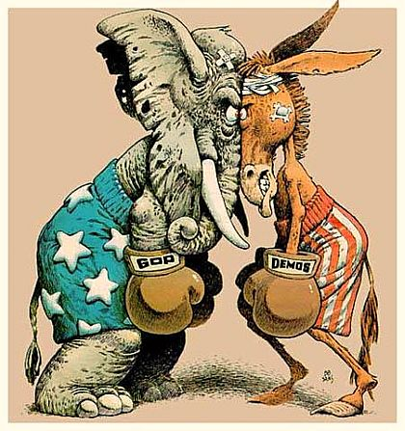
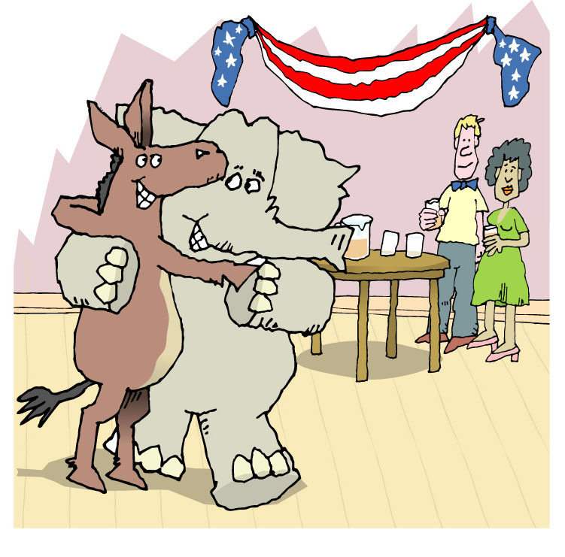
PARTISAN
VS.
BI-PARTISAN
Notes:
7

Slide 8
PARTY SYSTEMS:
Multi-party: 3 or more parties
One-party: single dominant party
Two-party: power shifts back and forth between 2 parties.
** Sometimes there can be 3rd party which doesn’t have a lot of power but can change election outcomes.
Notes:
8

Slide 9
What party system do we have in America?
Two-Party System

Slide 10
America’s 2 party system
The two major political parties in the US are the:
Republicans (Conservatives)
Democrats (Liberals)
You can register to vote as a Republican, a Democrat, or an Independent (you don’t belong to either party).
Notes:
10

Slide 11
Political Spectrum
Reactionary: Doesn’t support any change
Conservative: little change, individual freedom, small gov’t
Moderate: some reform
Liberal: Reforms, gov’t involvement to solve social problems.
Radical: Revolution, wants extreme change.
Right
Middle
Left
Notes:
11

Slide 12
Notes 40
Radical | Liberal Democrats | Moderate` | Conservative Republicans | Reactionary
Extreme change | Big gov’t, reforms | Some reform | Small gov’t, little reform | NO CHANGE
Ex: Switching from Republic to Anarchy | Ex: entitlement programs | Ex: Help for the homeless | Ex: Low taxes | Ex: Original constitution
Notes:
12

