Slide 1
Today’s Objective
SWBAT describe each of the guiding principles of the Constitution as well as the powers of each level of government.

Slide 2
PRINCIPLE
Please fill out the graphic organizer by following this example::
DEFINITION
PRINCIPLE
DEFINITION
Principles of the US Constitution

Slide 3
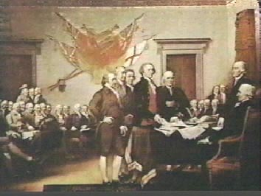


The U.S.
Constitution
Principles
of the Constitution

Slide 4

What does our Constitution represent?
There are 6 principles in the Constitution ….
Popular Sovereignty
Rule of Law/ Limited Government
Separation of Powers
Checks And Balances
Judicial Review
Federalism

Slide 5






Basic Principles
Popular Sovereignty
  Idea that power lies with
  the people

Slide 6
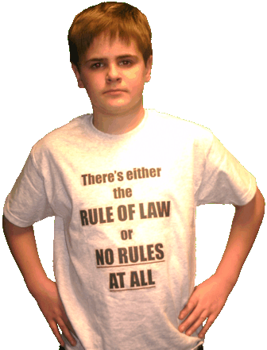
Rule of Law
Government is limited by the rule of law. This means that the law applies to everyone, even those who govern.
No One Is Above The Law!

Slide 7


Federalism
Creation of national and state governments
State Governments
National Government
Under federalism, power is shared by the national government and the states. Americans must obey the laws of both.

Slide 8
To keep any one person or group from becoming too powerful, the Framers divided government into three branches with different functions.
The split of authority is called Separation of Powers
Separation of Power
President
(Congress)
(Supreme Court)
For example, the president can veto laws, Congress can block presidential appointments, and the Supreme Court can overturn laws it finds contrary to the Constitution.

Slide 9


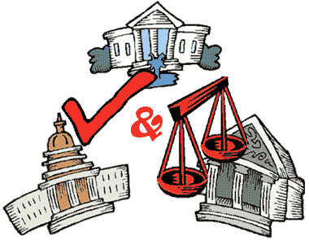
Checks and balances keep any one branch from becoming too powerful. Each branch can check, or restrain, the power of the others.
For example, the president can veto laws, Congress can block presidential appointments, and the Supreme Court can overturn laws it finds contrary to the Constitution.

Slide 10
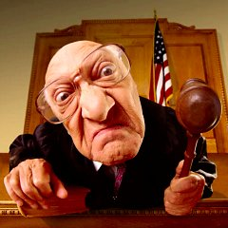
Judicial Review
This is the power of the Supreme Court to decide whether or not laws violate the Constitution.
Hmmm, constitutional or NOT?

Slide 11
Types of Powers
Enumerated Powers
  Powers given only to the federal government
  A.K.A. – Delegated Powers
Reserved Powers
  Powers reserved for state governments only
Concurrent Powers
  Powers shared between the state and federal governments

Slide 12
Federalism/Division of Powers
Delegated/Enumerated Powers
Reserved Powers
Powers RESERVED for states:
Health & Safety matters
Marriage/divorce laws
Business regulation
Licensing of professions
Both State & Federal:
Building roads
Borrowing money
Collecting taxes
Operating courts
Federal Powers:
Armed Forces
Coining money
Regulated trade
Making treaties
Concurrent Powers

Slide 13
Expressed Powers
  Powers of Congress that ARE specifically listed in the Constitution
  Ex: Congress can declare war
Implied Powers
  Powers that Congress has that ARE NOT specifically listed in the Constitution
  Ex: Create an Air Force

Slide 14
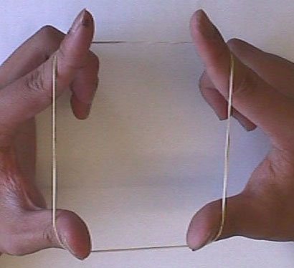
ELASTIC CLAUSE
The Constitution’s “necessary and proper” clause, also known as the “Elastic Clause” allows Congress to stretch its powers to do what they feel is what the country needs at the time. (In article 1)
For example, after WWII, Congress used these powers to begin an Air Force.

Slide 15
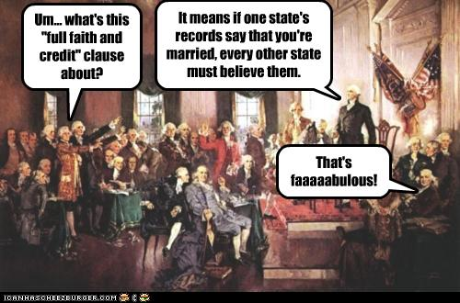
Full Faith and Credit Clause
Each state must give their “faith and credit” to another state by respecting their laws
Ex: North Carolina and Virginia have different speed limit laws. The speed limit on I-95 is 70 mph in NC,
but 65 mph in VA.
When you cross over into VA, you must follow their laws and not go over 65.
Notes:
15

Slide 16
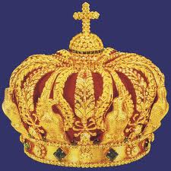
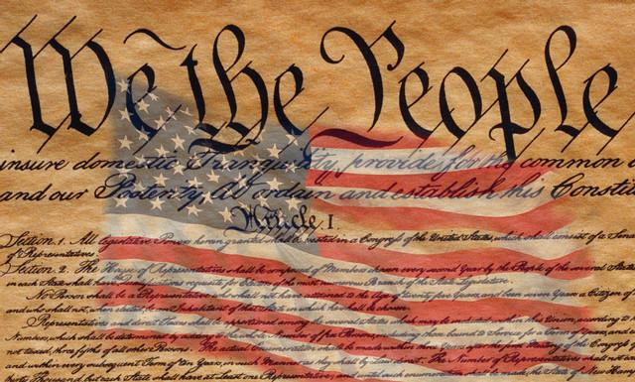
Supremacy Clause
Establishes the US Constitution as the “Supreme law of the land”
(http://en.wikipedia.org/wiki/Supremacy_Clause)

