Slide 1
The Road to Revolution
The American Colonies Under British Rule

Slide 2
Today’s Objective
SWBAT...interpret why certain events led the colonists to independence.
SWBAT defend the colonists reasons for writing the Declaration of Independence

Slide 3
Review Questions
What is self-government?
Why is the Magna Carta important for you to know about as a citizen?
Which founding document do you consider the most important to know? Why?

Slide 4
Mercantilism
Definition:
The colonial economy benefits the mother country
American Colonies benefit England
Wealth based on gold & bullion
The colonies were controlled markets for England
Raw materials were exported from colonies in order for the mother country to make a profit
Goal: favorable balance of trade
Navigation Laws/Acts
Colonies required to trade with England
Colonies buy England’s manufactured goods
Colonies sell England raw products
Use ships made in England
Colonies could not compete with England’s markets
Tax stops required when colonies traded with other nations
Notes:
Bullion 1 gold or silver in bulk before coining, or valued by weight.

Slide 5
How did England and the colonies interact?
Salutary Neglect –
England did NOT enforce law on the colonies until 1763
The non-enforcement of laws in known as salutary neglect
The colonies LIKED salutary neglect
Allowed the colonists to develop democratic institutions
Virginia House of Burgesses

Slide 6
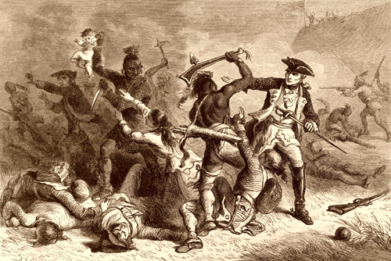
How did salutary neglect end?
French and their Indian Allies vs. British and American Colonists
Conflict: LAND (what land belonged to England and what land belonged to France?)
Treaty of Paris was signed in 1763 to end the war
All land east of the Mississippi was given to the British
Large war debt caused salutary neglect to end
British began to enforce trade laws.

Slide 7
French & Indian War (1754 – 1763)
Treaty of Paris was signed in 1763 to end the war
All land east of the Mississippi was given to the British
Large war debt caused salutary neglect to end
British began to enforce trade laws.

Slide 8
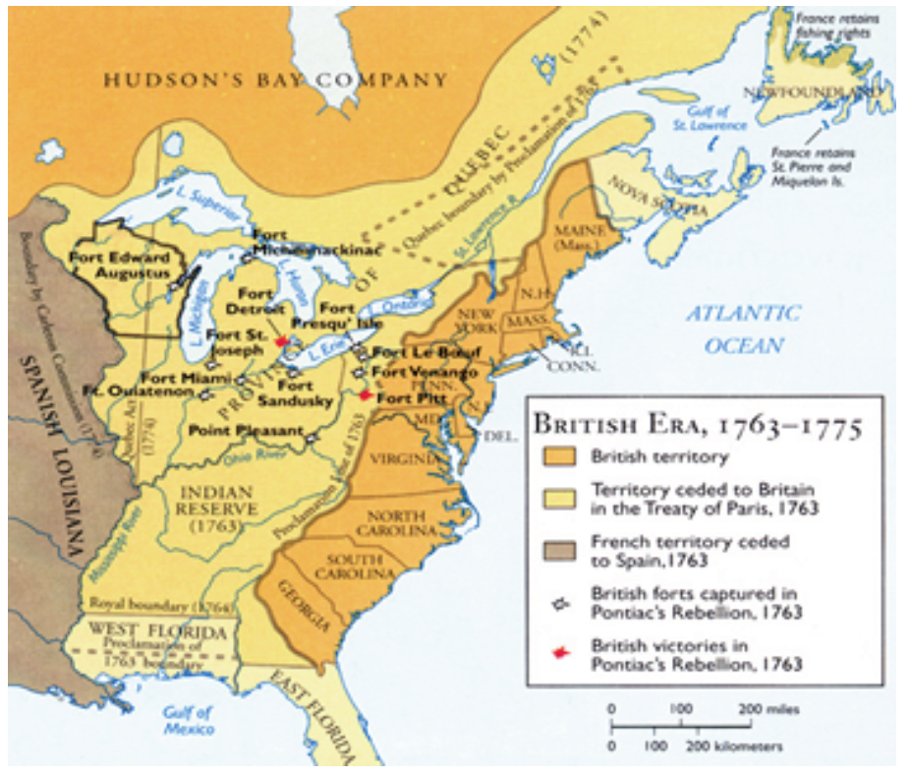

Slide 9
How did the French and Indian War impact the coloies?
British became much more stringent
END OF SALUTORY NEGLECT!
British felt colonists benefited from defeat of French but were ungrateful
England was now in major debt and had to find some way to pay off the war.
Proclamation of 1763
Ordered settlers to return east (right side of red line)
Could not enter region without approval from government

Slide 10
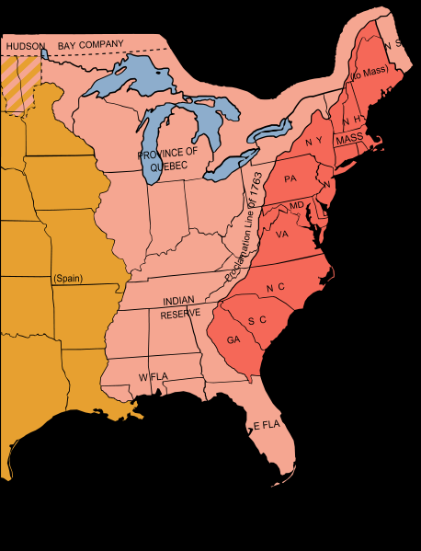

Slide 11
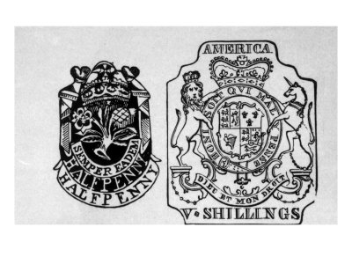
How did England expect to pay for the war?
Sugar Act (1764): tax on sugar-was highly enforced; reduced the tax amount from previous Molasses Act, but strengthened enforcement
Currency Act (1764): prohibited American colonist from issuing their own currency
Stamp Act (1765): required stamps to be purchased and placed on newspapers, almanacs, pamphlets, legal documents, and playing cards
Townshend Act (1767): taxes on glass, lead, paint, paper, and tea

Slide 12
Tea Act (1773): permitted the British East India Tea Comp. to sell tea at a lower price than colonial tea companies
“Intolerable Acts” (1774) → British response to Boston Tea Party
Boston Port Act: closed port of Boston
Massachusetts Government Act: unilaterally absorbed Mass. government under the control of the “crown”
Administration of Justice Act: allowed trials to be moved for “fair trials”
Quartering Act: allowed/required British soldiers be housed (private homes even)

Slide 13
How do the colonists respond?
“No taxation without representation” became the battle cry of the colonists.
What does that battle cry mean?

Slide 14
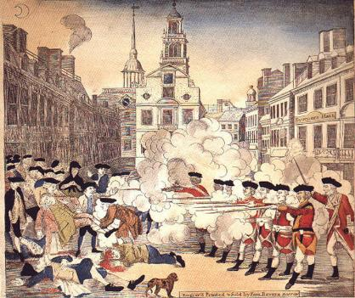
How do the British feel about the colonists?
Boston Massacre / “Incident on King Street”
Encounter between British troops and citizens of Boston
Patriots antagonized British troops, who were quartered in Boston to discourage demonstrations against the Townshend Acts.
British troops fired on the Patriots, killing 5 people.
Media “spin” job

Slide 15
Exit Ticket
Who came up with the idea for unalienable rights? What are they?
Do you feel the colonists had good reason to “break up” with England? Why or why not?
What was the main reason for colonists objecting to taxation by the British parliament?

