Slide 1
DO NOW: WEEK 14
DO NOW
1. What do YOU spend most of your money on?
2. What is it called when the government spends more than earns in revenue?
3. What do you think makes up the largest source of revenue for the federal government?
Notes:
1

Slide 2
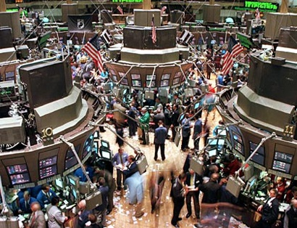
Goal 7 INTRO TO ECONOMICS
Notes:
2

Slide 3
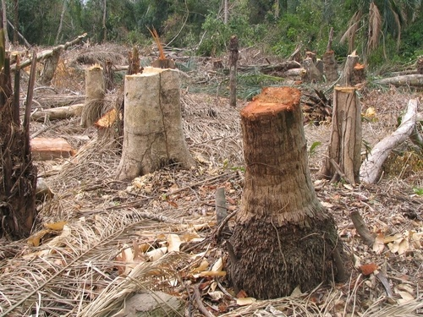
What is Economics?
Economics is the study of how we make decisions in a world where resources are limited.
It is sometimes called the science of decision making.
How do you choose what to buy when you only have a limited amount of money?
Notes:
3

Slide 4
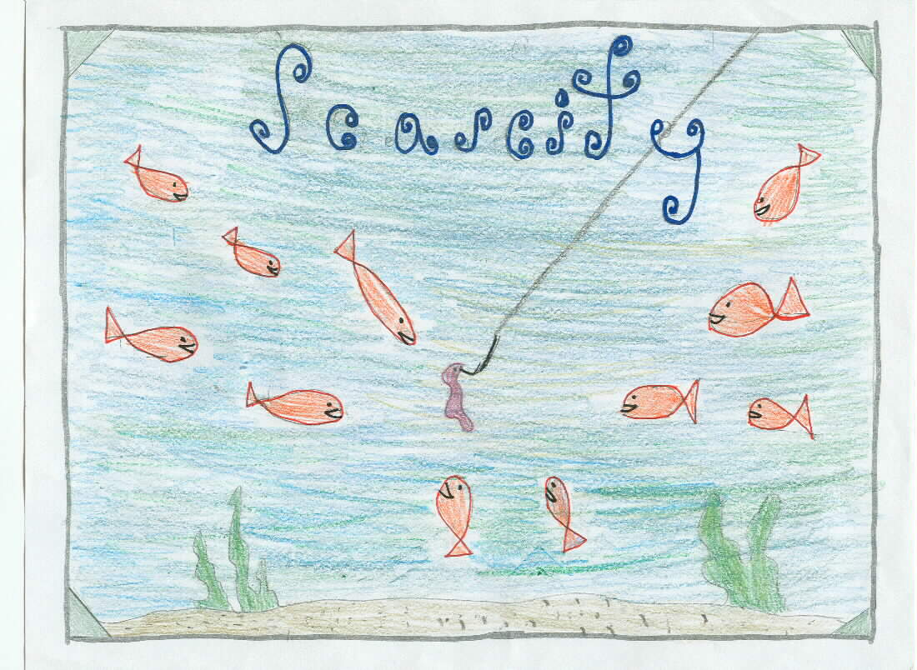
Scarcity
From this child’s drawing, predict what scarcity might mean
Notes:
4

Slide 5
What is the Fundamental Economic Problem?
The fundamental economic problem is SCARCITY— we have unlimited wants and limited resources!
Because of scarcity, we must make choices among alternatives.
Choose to Camp Out for an XBox 360, or Do Something Else
Notes:
5

Slide 6
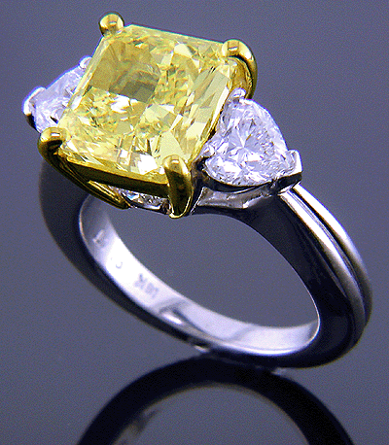
What is the Impact of Scarcity?
Why are diamonds expensive and water so cheap?
Scarce resource=high price
Abundant (not scarce) resource=low price
Notes:
6

Slide 7
Producers and Consumers
Producers: make goods and services
Motivated by profit ($$$)
Consumers: purchase and use goods/services to satisfy their wants and needs
Make decisions based on what needs and wants they want to satisfy with their limited “scarce” resources.
Notes:
7

Slide 8
Goods & Services
Producers make goods and services to be consumed by the public
Goods: tangible products such as cars, CDs and clothes
Services: intangible things like telephone service, Internet or medical/legal services.
Answer: When you watch TV there is a good and a service involved, what are they?
Notes:
8

Slide 9
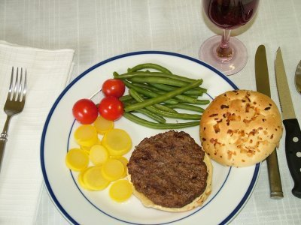
Needs vs. Wants
Needs are things we need for survival, such as food, clothing, and shelter.
Wants are things we would like to have.
Both needs and wants must be prioritized. What do you need the most? what do you want the most?
vs.
Notes:
9

Slide 10
Immediate vs. Delayed Gratification
If you choose to only consider the short term benefit of your purchase you are making a choice based on immediate gratification.
If you consider a longer term benefit of a purchase you are making a choice based on delayed gratification.
QUESTION: If you buy a Hummer because you like it the most right now is this immediate or delayed gratification?
If you buy a Honda accord because you know it will save you money on gas in the long run it is immediate or delayed gratification?
Notes:
10

Slide 11
List all of the things this school would have it was perfect in your mind. Think in terms of facilities and resources:
Why isn’t our school like this?
Resources are scarce meaning we don’t have everything we want to have in our school
Notes:
11

Slide 12
**5-step decision making model**
Recognition of a want or need
Information search
Evaluation of the alternatives
The purchase
Post-purchase evaluation
Notes:
12

Slide 13
**5-step decision making model** Imagine you have $100 complete the model
Recognition of a want or need
What do I want?
What do I need?
What do I need/want the MOST?
Information search
Which of my needs and wants could I actually satisfy given my resources ($100)?
Evaluation of the alternatives
Is there anything else I could do with the money besides spending it right away?
The purchase
Finalize which product you are going to buy
Post-purchase evaluation
What did you give up by spending your money on this purchase?
Would you make the same decision again?
Notes:
13

Slide 14
Step 2: Complete the model for the Board of Education
$5 million to spend on Harding University High School, decide what you need/want & complete the model
PRICES:
$50,000 for each highly qualified teacher
30 textbooks (1 class set) = $10,000
Interactive Classrooms = $10,000 per a classroom
New Gym = $4 million
New Classroom = $500,000 per a room
New Track = $3 million
Food Court = $5 million
Laptop for all students = $1 million
Wireless hi-speed internet = $2 million
Notes:
14

Slide 15
ABCD REVIEW
Which item is classified as a need?
A. bicycle
B. cell phone
C. DVD player
D. food

Slide 16
ABCD REVIEW
Which is the cause of scarcity?
A. the desire to gain profits
B. the desire to gain resources
C. unlimited needs
D. unlimited wants and limited resources

Slide 17
ABCD REVIEW
Which economic problem does a country face when it experiences a booming population but lacks sufficient coal and oil resources?
A. competition
B. opportunity cost
C. scarcity
D. trade-off

Slide 18
ABCD REVIEW
Which is the most likely impact on consumers of a reduction in fuel production?
A. a decrease in gas prices
B. an increase in gas prices
C. a decrease in mortgage rates
D. an increase in employment rates

Slide 19
How would a producer most likely react to consumers’ high demand for a product that is scarce?
A. increase the price of the product
B. decrease the price of the product
C. stop selling the product
D. ask for government regulations of the product

Slide 20
Factors of Production Goal 7
Labor
Capital
Entrepreneurship
Land
Notes:
20

Slide 21
NOTES 78
Production: Creation of goods/services
Productivity: measures how much a business produces of each good or service per each worker employed.
EX: How many hamburgers can each worker at McDonalds produce?
Total hamburgers / number of workers = Productivity
A) 100 hamburgers / 10 workers = ______
B) 100 hamburgers / 5 workers = _______
Productivity comparison: Which McDonalds would you want to own, A or B? Why?
Notes:
21

Slide 22
Efficiency: how much does it cost to produce each good or service
Ex: How much does it cost to make each hamburger?
Total cost of hamburgers / # produced= Efficiency
$100 for all hamburgers / 100 Hamburgers = _______
$200 for all hamburgers / 100 Hamburgers =_______
Efficiency Comparison→Which McDonalds do you want to own, A or B? Why?

Slide 23
Productivity and Efficiency
Producers want to maximize their productivity and efficiency in order to make a larger profit!
So, you want to get the MOST out of every worker and resource you can.
We know a business is efficient when the cost of producing a resource is not more than the price.
Example: It cost me $1 to make each burger and I can sell it for $2! What is my profit on each burger?
Notes:
23

Slide 24
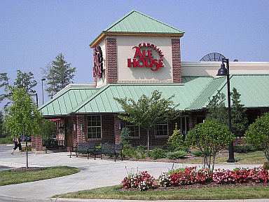
Thinking about productivity and efficiency:
Imagine you own a restaurant.
Should you hire A LOT of extra staff or just the exact number of people you need to run the restaurant?
What would happen if there were TOO many people?
What would happen if there were TOO few people?
What type of workers should you hire for your restaurant (think about qualities of good workers)?
Should you buy a lot of extra food or just want you need to meet the demand from customers?
What would happen if there was EXTRA food?
What would happen if you didn’t have enough food?

Slide 25
Factors of Production
ALL FOUR FACTORS MUST BE PRESENT TO PRODUCE ANY GOOD/SERVICE!
Land
Labor
Capital
Entrepreneurship
Notes:
25

Slide 26
Land
Adds natural resources necessary for production these are renewable and nonrenewable resources
Renewable Resources: trees, oxygen, water
Non-Renewable Resources: gold, oil, coal, gas
ANSWER: What is the difference between a renewable and nonrenewable resource?
Notes:
26

Slide 27
Which explains the need to protect natural resources?
A. Global warming is a direct result of using renewable energy.
B. Focusing on renewable energy sources will help the environment.
C. Nonrenewable energy sources can be sustained for thousands of years.
D. New oil production facilities will increase our ability to transport people.

Slide 28
Labor (workers)
Labor is the nation’s workforce or human resources. Sometimes it is called human capital.
It includes the physical and mental talents of the people who help produce goods and services.
Factors such as population growth, education, training and war affect the quantity and quality of labor.
Notes:
28

Slide 29
Capital
Capital, or capital goods, includes the tools, machinery, and buildings used to make other products.
Financial Capital is the money that goes into a new business
Consumer goods satisfy wants directly; capital goods do so indirectly by aiding production of consumer goods.
Notes:
29

Slide 30
Question
How are capital goods different from consumer goods?
Notes:
30

Slide 31
Answer/Suggestions
How are capital goods different from consumer goods?
Capital goods satisfy wants indirectly. They are the tools, machinery, and buildings used to produce consumer goods.
Notes:
31

Slide 32
Entrepreneurs
Entrepreneurs are individuals who start new businesses, introduce new products, create jobs and improve management techniques.
They are innovative and willing to take risks.
Brains of the economy: Entrepreneurs drive the economy because they use factors of production to produce new products & create jobs.
Notes:
32

Slide 33
Candy Bar
→So what factors of production go into the making/selling of a candy bar ?
Land
Labor
Capital
Entrepreneurship

Slide 34
ABCD
Which is a result of using factors of production in an efficient and cost effective manner?
Investment
labor
productivity
scarcity

Slide 35
Create your own product
Complete the table about how you will combine all 4 factors of production.
Land
Labor
Capital
Entrepreneurship
Notes:
35

Slide 36
For the following pictures tell me whether which factor of production they represent.
A: land
B: labor
C: capital
D: entrepreneurship

Slide 37
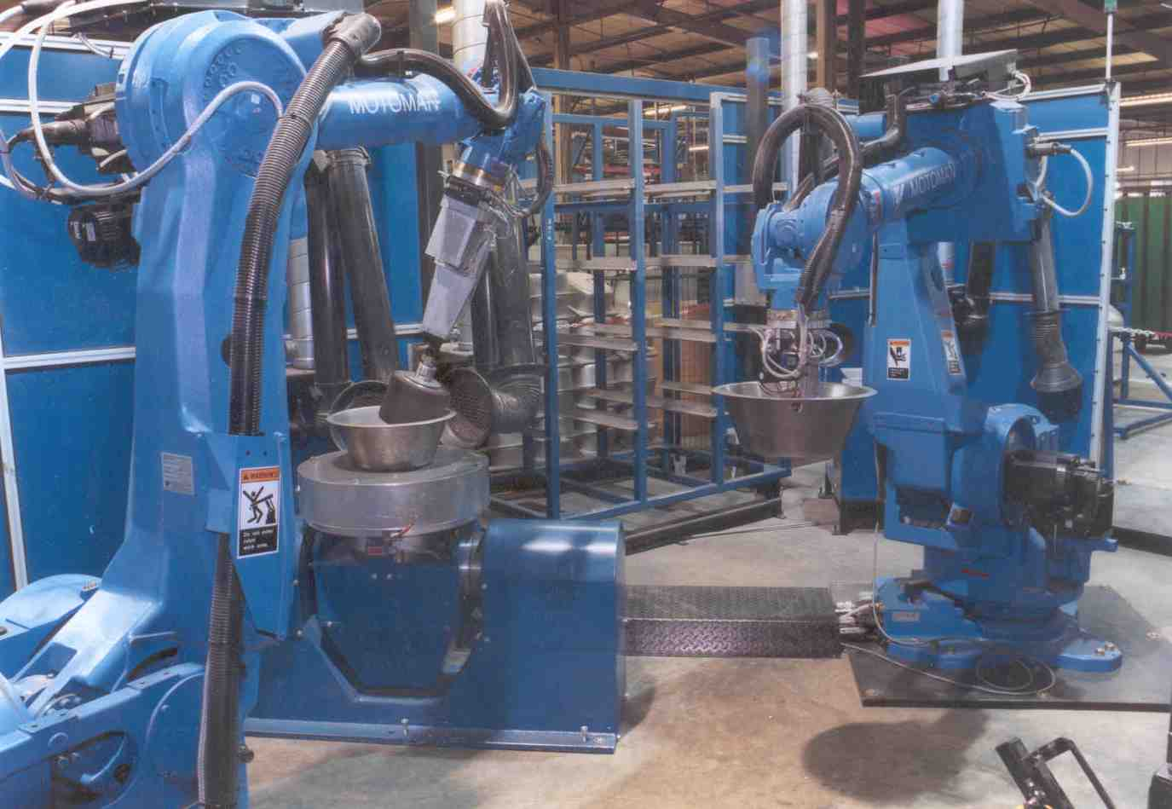
1. Capital
Notes:
37

Slide 38
2. Land/Resource →Is the renewable or non-renewable?
Notes:
38

Slide 39
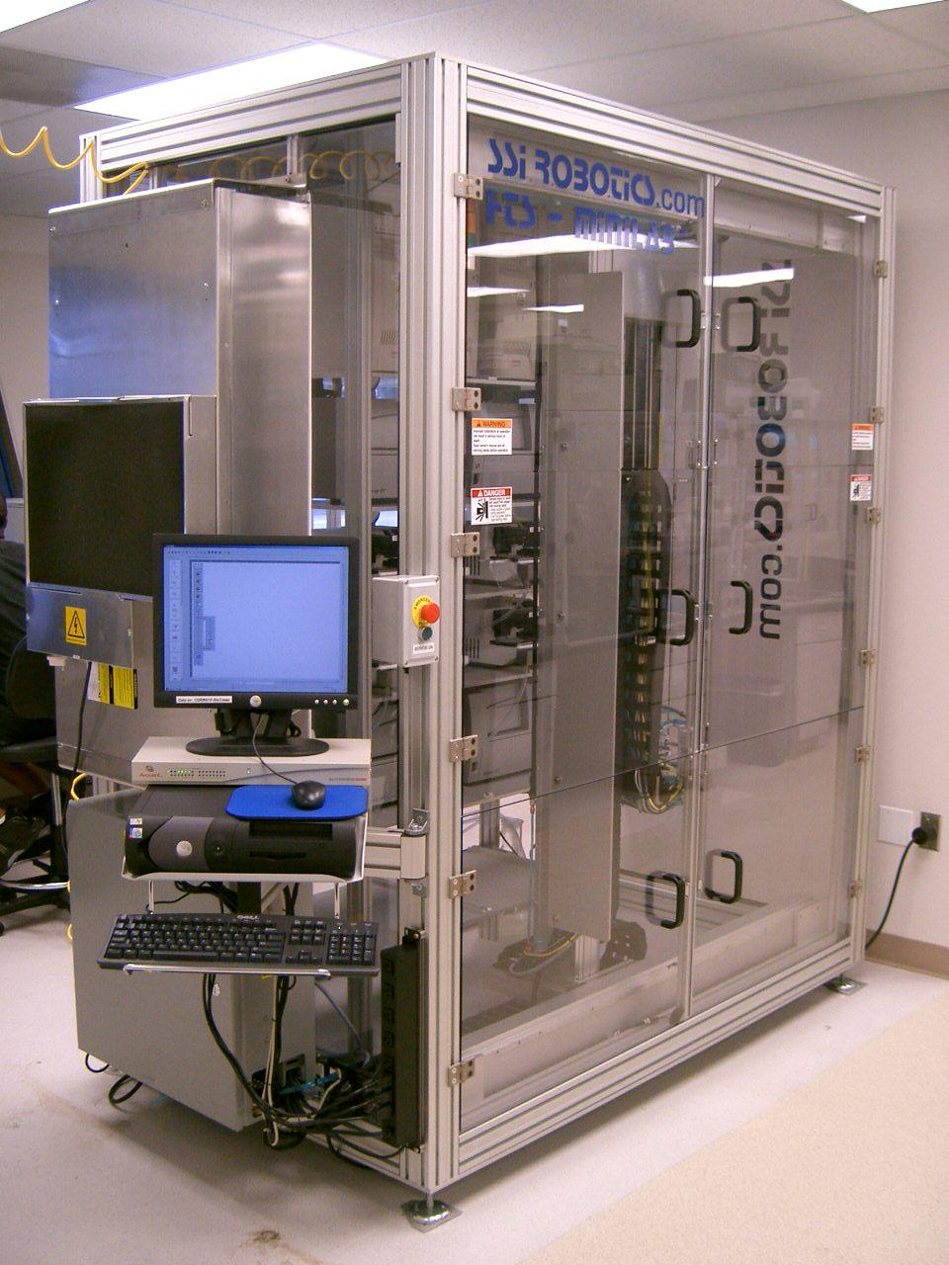
3. Capital
Notes:
39

Slide 40
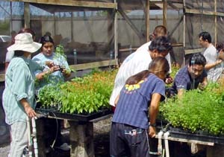
4. Labor
Notes:
40

Slide 41
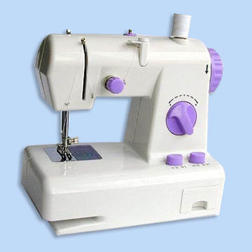
5. Capital
Notes:
41

Slide 42
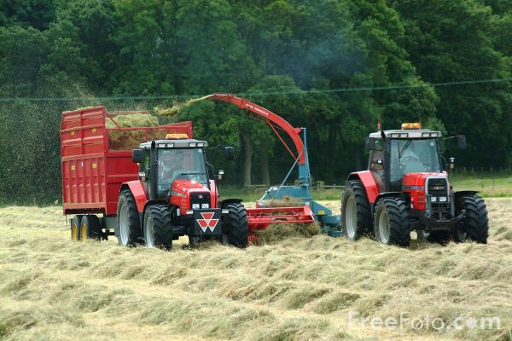
6.
A)
B)

Slide 43
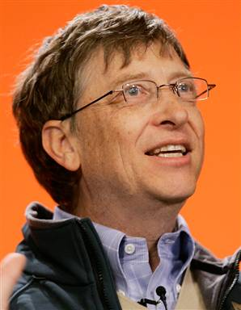
7. Entrepreneurship
Notes:
43

Slide 44
8. Land/Resource
Notes:
44

Slide 45
10. Labor
Notes:
45

Slide 46
Land/Resource: renewable or nonrenewable??
Notes:
46

Slide 47
12. Entrepreneurship
Notes:
47

Slide 48
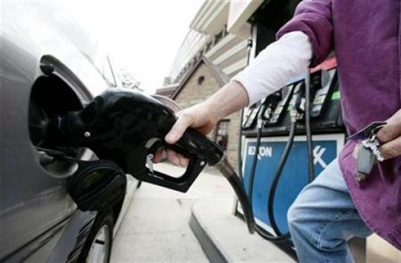
12. Land/Non-Renewable or renewable?
Notes:
48

Slide 49
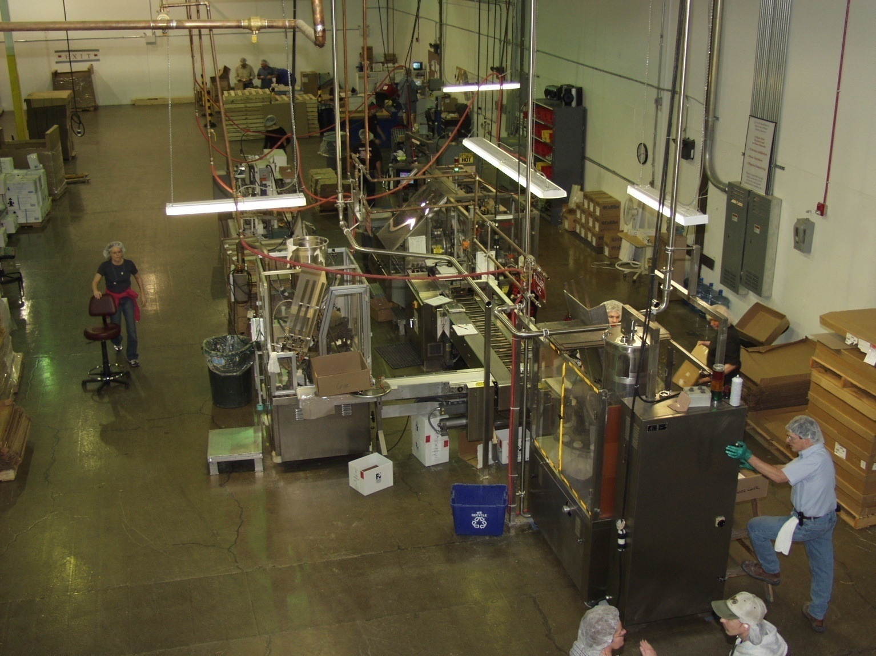
13. Capital
Notes:
49

