Slide 1
Supply & Demand
Putting it all together!
Notes:
1

Slide 2
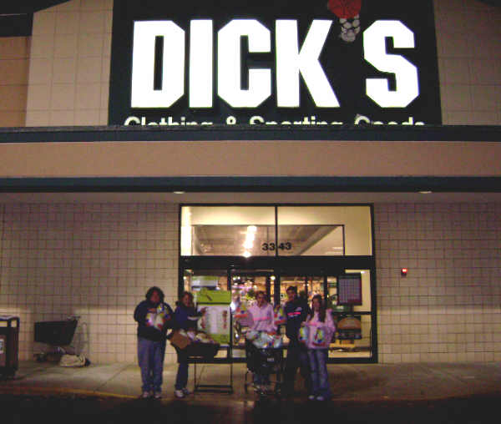
Situation #1
Dick’s Sporting Goods goes out of business. What is the impact on the supply of basketballs?
Notes:
2

Slide 3
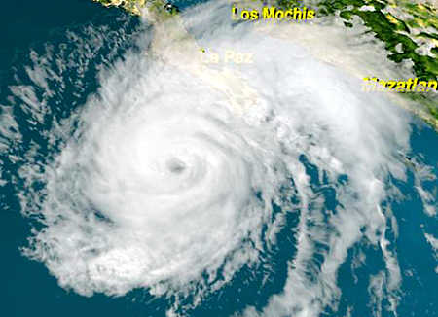
Situation #2
A hurricane destroys the orange groves in Florida. What is the impact on the supply of Orange Juice?
Notes:
3

Slide 4
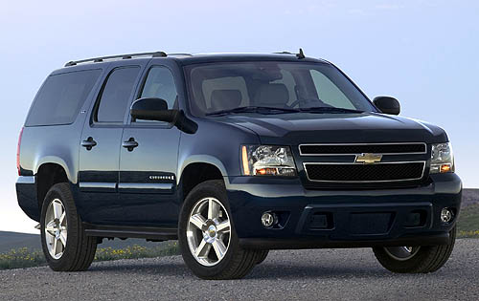
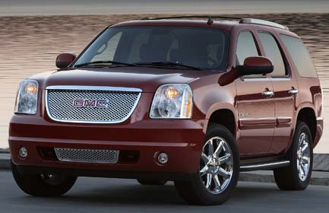
Situation #3
The price of gas increases, decreasing the consumer demand for large SUVs. What happened to the supply of SUVs?
Notes:
4

Slide 5
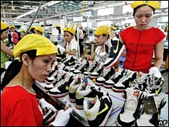
Situation #4
Nike moves their factory from the U.S. to China to avoid having to pay its workers minimum wage. What is the impact on the supply of Nike’s shoes?
Notes:
5

Slide 6
A Fully labeled Supply & Demand Graph
S1
P
Equilibrium Price: the price at which the amount producers are willing to supply is equal to the amount consumers are willing to buy
E1
P1
Market Clearing Price
D1
Q
Q1
Notes:
6

Slide 7
Orange Juice
PRICE ____
QUANTITY____
BECAUSE OF A CHANGE IN
SUPPLY
S2
S1
P
E2
P2
E1
P1
D1
Q2
Q1
Q
Notes:
7

Slide 8
Coca-Cola
PRICE ____
QUANTITY____
BECAUSE OF A CHANGE IN
DEMAND
S1
P
E1
P1
E2
P2
D2
D1
Q2
Q1
Q
Notes:
8

Slide 9
Video Games
PRICE ____
QUANTITY____
BECAUSE OF A CHANGE IN
DEMAND
S1
P
E2
P2
E1
P1
D1
D2
Q1
Q2
Q
Notes:
9

Slide 10
Clothing
PRICE ____
QUANTITY____
BECAUSE OF A CHANGE IN
SUPPLY
S1
P
S2
E1
P1
E2
P2
D1
Q1
Q2
Q
Notes:
10

Slide 11
Price Ceiling
S1
P
An artificial barrier that creates a maximum price for a good/service
Tries to keep prices low but creates shortage
E1
MCP
Price Ceiling
D1
Q
Notes:
11

Slide 12
Example: Price Ceiling
1) In New York City the government controlled the rent on some apartments so that they could not be more than $1000 a month. This made everyone want those cheap apartments, but there wasn’t enough of them for everyone who wanted one.
What is this called?_________________

Slide 13
The quick way to remember
Ceiling = max price = shortage

Slide 14
Price Floor
S1
P
An artificial barrier that creates a minimum price for a good/service
Tries to keep businesses happy but creates surplus
Price Floor
E1
MCP
D1
Q
Notes:
14

Slide 15
Example: Price Floor
1) In July the minimum wage in North Carolina will go up to $7.25. It will be illegal to pay someone less than that for any type of job. But many businesses can’t afford to pay their workers $7.25 an hour. This will mean people are going to lose their jobs.
What will happen to the available supply of labor?_________________
What is this called? __________________

Slide 16
The quick way to remember
Floor = min price = surplus

Slide 17
Floor or Ceiling? Remember… Floor = minimum price Ceiling = maximum price
1. The Congress wanted to help America’s 3 big car companies (Ford, GM & Chrysler) make more profit. They said that new cars could not be sold for less than $30,000.
Is this a price floor or a price ceiling?
What will happen to the supply of cars?

Slide 18
Floor or Ceiling? Remember… Floor = minimum price Ceiling = maximum price
2. The Congress wanted people to be able to afford gas this summer so they said that no gas could be sold above $1.25 a gallon. But during the summer the demand for gas is always higher because people travel more.
Is this a price floor or a price ceiling?
What will happen to the supply of gasoline?

