Slide 1
Supply
Notes:
1

Slide 2
Objectives
SWBAT explain how supply shifts and affects price
Notes:
2

Slide 3
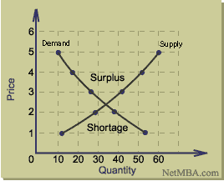
DO NOW
Predict
What happens to the quantity supplied as price goes UP?
What happens to the quantity supplied as the price goes DOWN?
Notes:
3

Slide 4
Supply Curve
S1
As price increases, quantity supplied increases.
Because producers would rather sell goods at a higher price
Price
Quantity
Notes:
4

Slide 5
Supply Schedule
Supply: measures how much producers are willing to make at various prices
Ex. Pizza Supply Schedule.
How many pizzas are supplied at $1.00?
As the price of pizza increased what happened to supply?
What do you think prevents a producer from selling goods at the high prices?
Price
Quantity
$.50
1
$1.00
2
$1.50
5
$2.00
7
$2.50
8
Notes:
5

Slide 6
Law of Supply “The UP UP DOWN DOWN”
As price goes up quantity goes up
As price goes down quantity goes down
Producers make more goods/services at higher prices then they do at lower prices.
Have you heard about the Supply Dance?
Notes:
6

Slide 7
Illustration of Supply Shift
Decrease in Supply = curve shifts to the left.
Increase in Supply = curve shifts to the right
S2
S1
Price
S1
Price
S2
Quantity
Quantity
Notes:
7

Slide 8
Why does supply shift?
Supply can increase (move right) and Decrease (move left) depending on certain conditions in the market.
STOP and Think…if it reduces the cost of production (cheaper to produce) then supply of that good went ____.
Notes:
8

Slide 9
Supply Factors
1. Number of suppliers: more suppliers = more supply
Example: A new shopping plaza opened on 56 in Louisburg. Did the # of suppliers increase or decrease? Did supply increase or decrease?

Slide 10
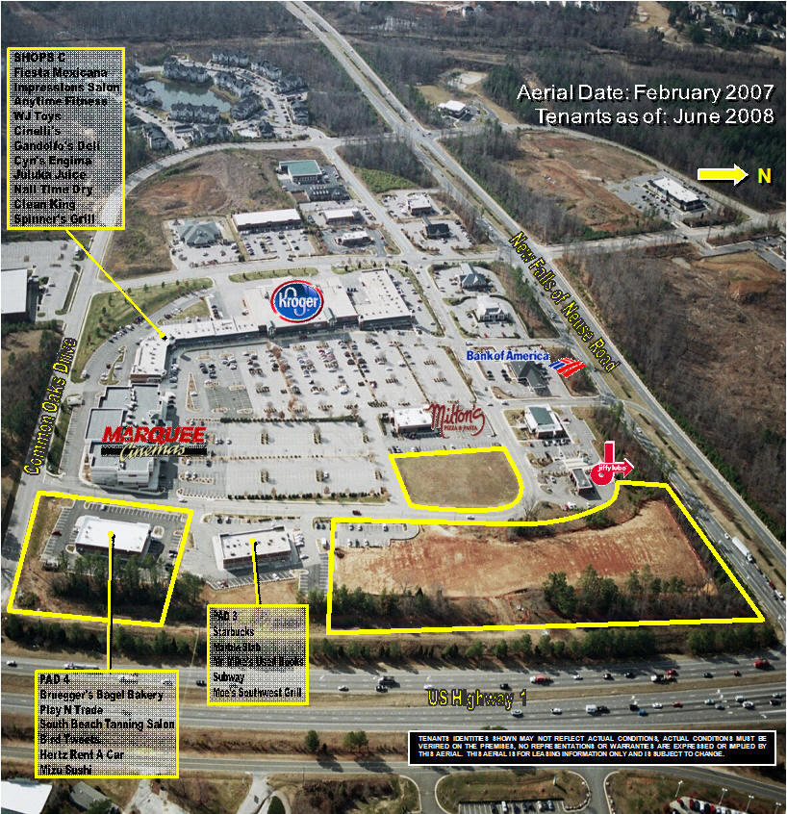
Example: A new shopping plaza opened on 56 in Louisburg. Did the # of suppliers increase or decrease? Did supply increase or decrease?

Slide 11
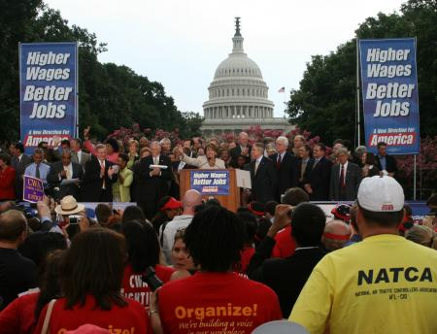
Supply Factors
2. Government Regulations: tighter government regulation of production makes it more expensive to supply goods→ decrease in supply
Example: Congress raised the minimum wage to $6.55 an hour from $7.25. What is the impact for fast food restaurants? Did the supply of fast food increase or decrease?

Slide 12
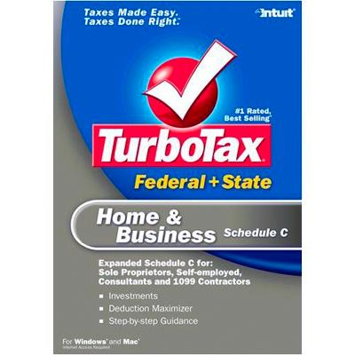
Supply Factors
3. Taxes: Higher taxes raises business costs (supply decrease), lower taxes reduces them (supply increase)
Example: Congress cut the tax on American corporations to try and boost production in the United States. Did costs for corporations go up or down? Did supply increase or decrease?

Slide 13
Supply Factors
4. Subsidies: gov’t payment to an individual, business, or group to reduce the cost of production.
Example: Congress gave all corn producers a subsidy for each bushel of corn they produce. Did the cost of corn production go up or down? Did the supply of corn increase or decrease?

Slide 14
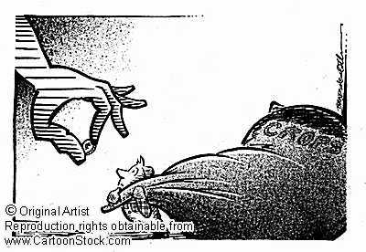
In America Subsidies have lowered the price for agricultural goods.
Notes:
14

Slide 15
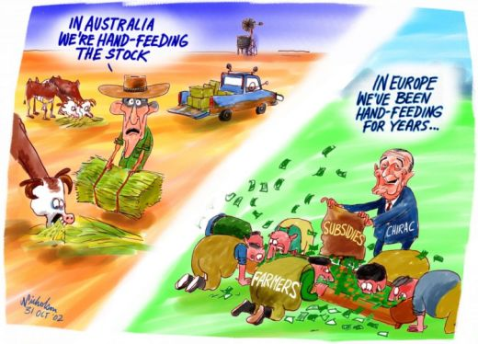
Problem with big subsidies
Subsidies make agricultural products in the US and Europe much cheaper. No other countries can farm for as cheap as we can because they don’t get money from the gov’t (subsidy).
Notes:
15

Slide 16
Supply Factors
5. Producer Expectations: If producers think that consumer demand will drop, then they reduce supply. If they think demand will increase then they increase supply.
Example: As the weather gets warmer near the end of the school year clothing stores expect consumers will want to buy summer clothes. Did the supply of winter clothes increase or decrease? Did the supply of SUMMER clothes increase or decrease?

Slide 17
Fun with Supply Shifts!
Price
1.
Scenario | Supply Factor | Increase or Decrease? | Graph
Congress just voted to raise taxes on corporations to pay for entitlement programs
Quantity
Notes:
17

Slide 18
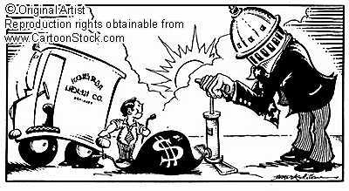
Fun with Supply Shifts!
Price
2.
Quantity
Scenario | Supply Factor | Increase or Decrease? | Graph
Congress just passed a bill giving all cotton producers $2 for every bushel of cotton produced
Notes:
18

Slide 19
Fun with Supply Shifts!
Price
3.
Scenario | Supply Factor | Increase or Decrease? | Graph
Congress requires all businesses to give male employees 1 month of paternity leave
Notes:
19

Slide 20
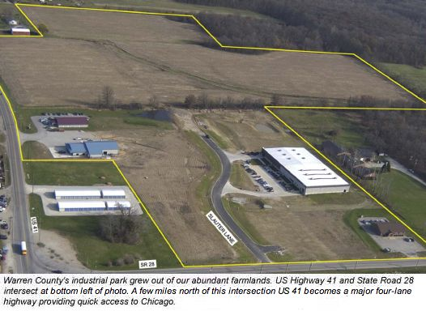
Fun with Supply Shifts!
Price
4.
Quantity
Scenario | Supply Factor | Increase or Decrease? | Graph
A new industrial park was built in Franklin County.
Notes:
20

Slide 21
Fun with Supply Shifts!
Price
5.
Quantity
Scenario | Supply Factor | Increase or Decrease? | Graph
Producers think that demand is going to drop for Regular TVs when all TVs go to Hi-Def.
Notes:
21

Slide 22
6,7&8
With a partner write a supply shift scenario.
Make sure you know what the “supply” is, whether demand increased or decreased and how to draw the graph.
Check their answer
Repeat for #7 and 8
Notes:
22

Slide 23
Minute Paper
Describe in your own words three ways that supply could change.
Notes:
23

