Slide 2
DO NOW
Which factor of production could be called the “brains behind the economy”?
Give an example of a capital good:
Give an example of a non-renewable resource:
Notes:
2
In 1770, and then again in 1773, the king of England passed a Quartering Act, which required the colonists in America to house and feed soldiers of the Royal Army. After the Bill of Rights was passed, did the people still have to house soldiers if the president says so? Why or why not?
In June 2002, the Ninth Circuit U.S. Court of Appeals ruled that the phrase “under God” was unconstitutional. Why? (Name the amendment—the number and what it says) What do you think about it?

Slide 3
This past weekend or week did you spend money on something or time doing a certain activity?
Tell what you spent time or money on:
Tell what you could have spent time or money instead of that purchase or activity.
Notes:
3

Slide 4
Every CHOICE you make has a…
Monetary cost: price you paid for a decision
Ex: cost of new car= $18,000
Notes:
4

Slide 5
Costs and Trade-offs
Trade off: all of the alternative choices in a decision
EX: With $18,000 you could have…
bought new clothes
saved for college
gone on vacation
We call all these items (clothes, college, vacation) trade-offs.
Notes:
5

Slide 6
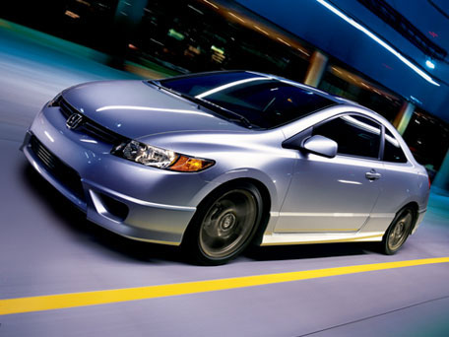
Opportunity cost: the NEXT BEST use of your time and money.
Ex: The opportunity cost of buying a car is now you don’t have that money for college.
Notes:
6

Slide 7
Understanding Opportunity Costs
What else could we have done with the $18,000?
The opportunity cost of buying a new car is that I did not get to go on a vacation.
Now you tell me using another trade-off.
The opportunity cost of buying a new car is that ______________________.
Notes:
7

Slide 8
Identify the Monetary Cost, Opportunity Cost and Trade-offs
SCENARIO: You decide to go to college for $17, 500 a year at UNC-Chapel Hill. You will attend for 4 years = $70,000. During this time you must spend time studying, attending class and cannot have a full time job that would earn $18,000 a year.
Monetary cost:
Trade-offs:
Opportunity cost:
Notes:
8

Slide 9
Incentives
Businesses use incentives (forms of encouragement) to influence consumer economic decisions.
Ex: buy 2 get 1 free! Happy Meal toys, Frequent Flyer miles.
Notes:
9

Slide 10
Business Costs
Fixed Costs: Business costs that DO NOT depend on the level of production (rent, salary)
EX: Rent, a business must pay rent on its factory whether the factory is operating or not.
Variable Costs: Costs that depend on a firm’s level of production.
Ex: a business received a large order, and must pay its workers overtime.
Did variable costs increase or decrease?
Notes:
10

Slide 11
Business Costs
Total Costs: fixed costs + variable costs = overall cost of production
EX: Rent of factory + overtime = total cost of production.
Notes:
11

Slide 12
Costs
Marginal Costs: the cost of producing one additional unit of a good or service.
Ex: it costs $1500 to produce 30 bike helmets. It costs $1550 to produce 31 bike helmets.
ANSWER: What is the marginal cost?
Notes:
12

Slide 13
Benefit
Marginal Benefit: The benefit of producing one additional unit of a good or service.
EX: The bike helmet company sold 30 bike helmets for $1600 in total profit. It sold 31 bike helmets for $1651 in total profit.
ANSWER: What is the marginal benefit?
Notes:
13

Slide 14
Cost Benefit Analysis
Compares marginal costs and marginal benefits in a decision.
Ex: When you compare the marginal costs and marginal benefits in the bike helmet scenario what is the result?
Marginal benefit =
Marginal cost =
So which is greater the cost or the benefit?
So should I make 30 helmets or 31?
Notes:
14

Slide 15
 | #1 | #2 | #3 | #4
Tradeoffs
Opportunity Cost
Monetary Cost
Notes:
15

Slide 16
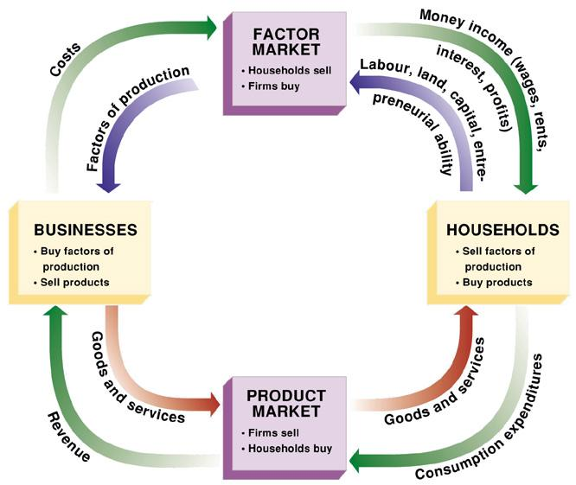
Notes:
16

Slide 17
Before anything is created producers must answer the 3 economic questions.
What to produce?
How to produce?
For whom to produce?

Slide 18
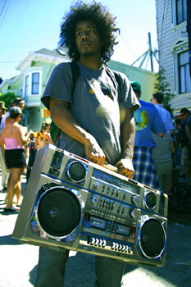
What to Produce?
DESCRIPTION: A society or business must decide what to produce with its limited resources.
Business Example: “Should we make stereos or MP3 players?”
Gov’t Example: “Should we make weapons or build more schools?”
MP3 Players
Boombox
OR
Notes:
18

Slide 19
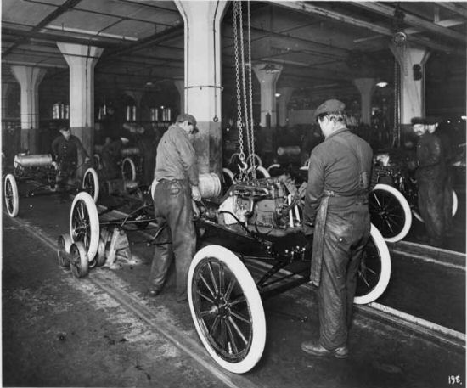
How to Produce?
DESCRIPTION: Society must decide how to produce various products to maximize efficiency and productivity.
Example: Should we use people or machines to make cars?
Assembly Line Model T Ford
Notes:
19

Slide 20
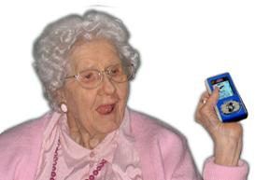
For Whom to Produce?
DESCRIPTION: Society or business must decide for whom goods and services will be made.
Example: Who do we want to buy our goods?
Are Electronics Produced for All Ages to Enjoy?
Notes:
20

Slide 21
Circular flow model
It shows how our economy works
It shows how goods and services, money, and the factors of production are exchanged between households and firms in the economy.

Slide 22
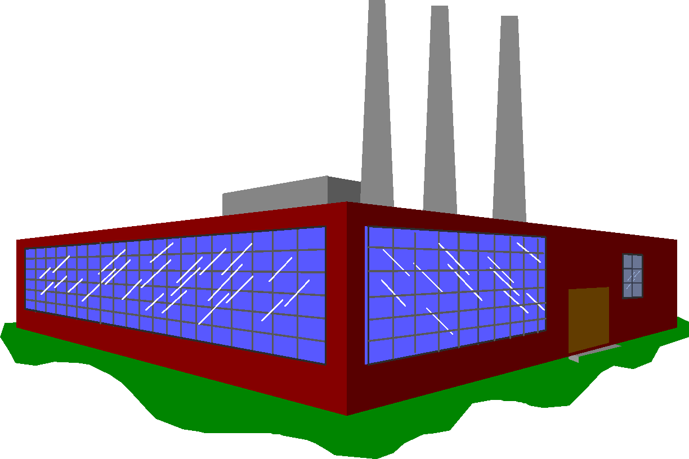
The two main parts of the Circular Flow model are firms and households. FYI: Firm is another word for “business”
FIRM
Household
fig
Notes:
22

Slide 23
The circular flow of goods and incomes
fig
Notes:
23

Slide 24
The circular flow of goods and incomes
Goods and services
fig
Notes:
24

Slide 25
The circular flow of goods and incomes
Goods and services
fig
Notes:
25

Slide 26
The circular flow of goods and incomes
Goods and services
$
Consumer
expenditure
fig
Notes:
26

Slide 27
The circular flow of goods and incomes
Goods and services
$
Consumer
expenditure
fig
Notes:
27

Slide 28
The circular flow of goods and incomes
Goods and services
$
Consumer
expenditure
fig
Households supply the factors of production (labor, etc)
Notes:
28

Slide 29
The circular flow of goods and incomes
Goods and services
$
Consumer
expenditure
fig
Households supply the factors of production (labor, etc)
Notes:
29

Slide 30
The circular flow of goods and incomes
Goods and services
$
Consumer
expenditure
Income: Wages, rent
dividends, etc.
$
fig
Households supply the factors of production (labor, etc)
Notes:
30

Slide 31
The circular flow of goods and incomes
Goods and services
$
Consumer
expenditure
Income: Wages, rent
dividends, etc.
$
fig
Households supply the factors of production (labor, etc)
Notes:
31

Slide 32
FIRMS:
Firms purchase the factors of production (___________, __________, _________, &_____________) on the factor market.
Then firms use the factors of production to create goods & services
Then firms sell goods & services to households to earn profits.

Slide 33
HOUSEHOLDS
Households purchase goods & services on the product market.
They are able to do this because they earned money by selling their labor (a factor of production) to firms.

Slide 34
Do you get it?
Who provides firms with the factors of production?
Who purchases good & services?
Who creates goods & services?
What do households get in return for providing labor to firms?
What must a firm have in order to produce any good or service?
BONUS:
Where do firms get the money to purchase the factors of production?
Where do households get the money to buy goods & services?

Slide 35
EOC Practice
If you buy a new CD and as a result you cannot afford to buy a stereo to play it on, economists would say this is a good example of which of the following?
Opportunity cost
Experience gain
Marginal Cost
Denial
Notes:
35

Slide 36
EOC Practice
Which of the following is not one of the major questions that a society must answer in order to give people the products they want?
How should goods be produced?
Will the goods have resale value?
What goods should be produced?
For whom will the goods be produced?
Notes:
36

Slide 37
If your city made a trade-off to spend $1 million on a recycling facility instead of a community college, what would be the opportunity cost of a cleaner environment?
Fewer fit and healthy people
Fewer colleges
Less garbage to dispose of
Fewer employed people

Slide 38
EOC Practice
Amy is invited to a party and has basketball tickets for the same night. If she decides to go to the basketball game what is her opportunity cost?
Money spent on food for the party
The memories from the basketball game
Money spent on the basketball tickets
The experience of the party

Slide 39
EOC Practice
Which of the following best describes the role of households within the circular flow model?
a. They collect taxes from businesses and individuals
b. They produce goods and services to sell to consumers
c. They sell labor to businesses and consume goods and services
d. They pay wages to government

Slide 40
Scenario #1
The Bullard family buys a computer for $1,899 instead of going to Disney world on vacation (also costs $1,899). They also could have put the money in Wendy’s college fund or for a down payment on a new car.
Notes:
40

Slide 41
Scenario #2
The US Government spends $1 billion dollars on paying troops in the Iraq War. It could have spent the money on improving roads, researching a cure for cancer, or improving public education.
Notes:
41

Slide 42
Scenario #3
Ms. Smith bought a new bedroom set for $2000 instead of going on a cruise with her husband. She could have also used that money to buy a flat screen TV or put it into a savings account.
Notes:
42

Slide 43
Scenario #4
Larry decided to study Friday night for his exam on Monday rather than go out with his friends to the movies. He could have also gone to the basketball game or stayed home and played board games with his family.
Notes:
43

Slide 44
abcd
Which is the best example of a fixed business cost?
Rental payment
Cost of fuel
Cost of natural resources
profit

Slide 45
Which category includes a coffee maker, a can of soda, toilet paper, and pencils?
capital goods
consumer goods
human capital
investments

Slide 46
abcd
Which is a result of the economic decision to recycle?
Production slows down.
More waste is produced.
People buy more merchandise.
Fewer raw materials are used.

Slide 47
abcd
Which of the following is the best example of immediate gratification?
Spending a rare coin on a movie ticket instead of waiting to sell the coin to a coin collector.
Buying the most efficient water heater
Deciding to eat out later rather than eating at home sooner
Taking a high paying job instead of one with more vacation time

Slide 48
Which of the following is an example of a business increasing its investment in capital?
Shoe company purchases new machinery
A shoe company purchases more fuel for transportation
A shoe company purchases more land for its expansion
The entrepreneur gives himself a raise.

