Slide 1
Types of Economies
Notes:
1

Slide 2
Goal 8: The US ECONOMY
Notes:
2

Slide 3
RAP 77
DO NOW- answer on your paper. Be prepared to defend your answer
Agree or Disagree?
The government should own all businesses.
The government should regulate(monitor) business.
Business should be owned by citizens.
You should do the same job your parents did.
Technology should be used to increase production.
You should be paid based on your level of skills.
All workers should be paid equally.
The government should never tell business what to do.
The government should decide what businesses should make.
Businesses should produce according to what the consumers want.
Businesses should compete to find the best way to produce the most goods and services.
Notes:
3

Slide 4
In America…
Who makes the decision about what job you have?
Who makes the decision about what you buy?

Slide 5
What are the three economic questions?
What to produce?
How to produce?
For whom to produce?

Slide 6
The answers to the three economic questions are different for each type of economy.
How people satisfy their wants also distinguishes each type of economy.

Slide 7
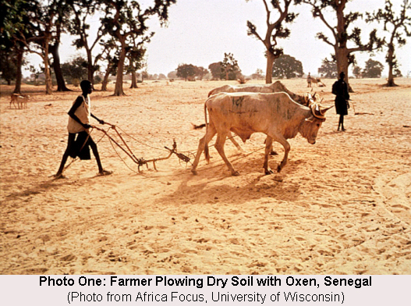
Traditional Economy: things are done “the way they have always been done.”
Ex: you farm the same way your great-great grandfather farmed.
Little new technology.
Custom & Habit determines the answers to the three basic economic questions.
Notes:
7

Slide 8
Command Economy: All businesses are owned & operated by the government for the benefit of all citizens.
People are paid equally even though they do different jobs.
Nicknames: Communism, Marxism, planned economy
Examples: Cuba, North Korea
Government determines the answer to the three economic questions
Notes:
8

Slide 9
Market Economy -production and exchange is regulated by competition between individuals (households) and businesses (firms).
People have the right to own private property
Individuals and Firms make decisions based on what is in their best interest.
Businesses produce goods for profits = “Profit Motive”
Everyone’s needs will be met b/c producers will make the most profit by making what consumers want.
Producers SUPPLY what is DEMANDED by consumers.
Notes:
9

Slide 10
Market economy cont’d
Nicknames: Laissez-Faire “hands off,” Capitalism, Free Enterprise System, Invisible Hand
Examples: USA, England, Germany, Japan
Competition answers the 4 economic questions.

Slide 11
Mixed Economy
The Mixed Economy: combination of a market and command economy.
Market and the gov’t answer the 3 economic questions.
Gov’t regulates business to protect environment and workers.
EX: In a Meat Packing plant the government regulates working conditions and the level of sanitation of the plant.
America is a market economy and a mixed economy because we some have gov’t regulation (min. wage, no monopolies, pollution limits, etc) on firms.

Slide 12
EXIT SLIP
If these economies were a song, which song would they be?
Ex: For Mixed economy I choose “Best of Both Worlds” by Hannah Montana because Mixed economy combines Market and Command

